Slide 1
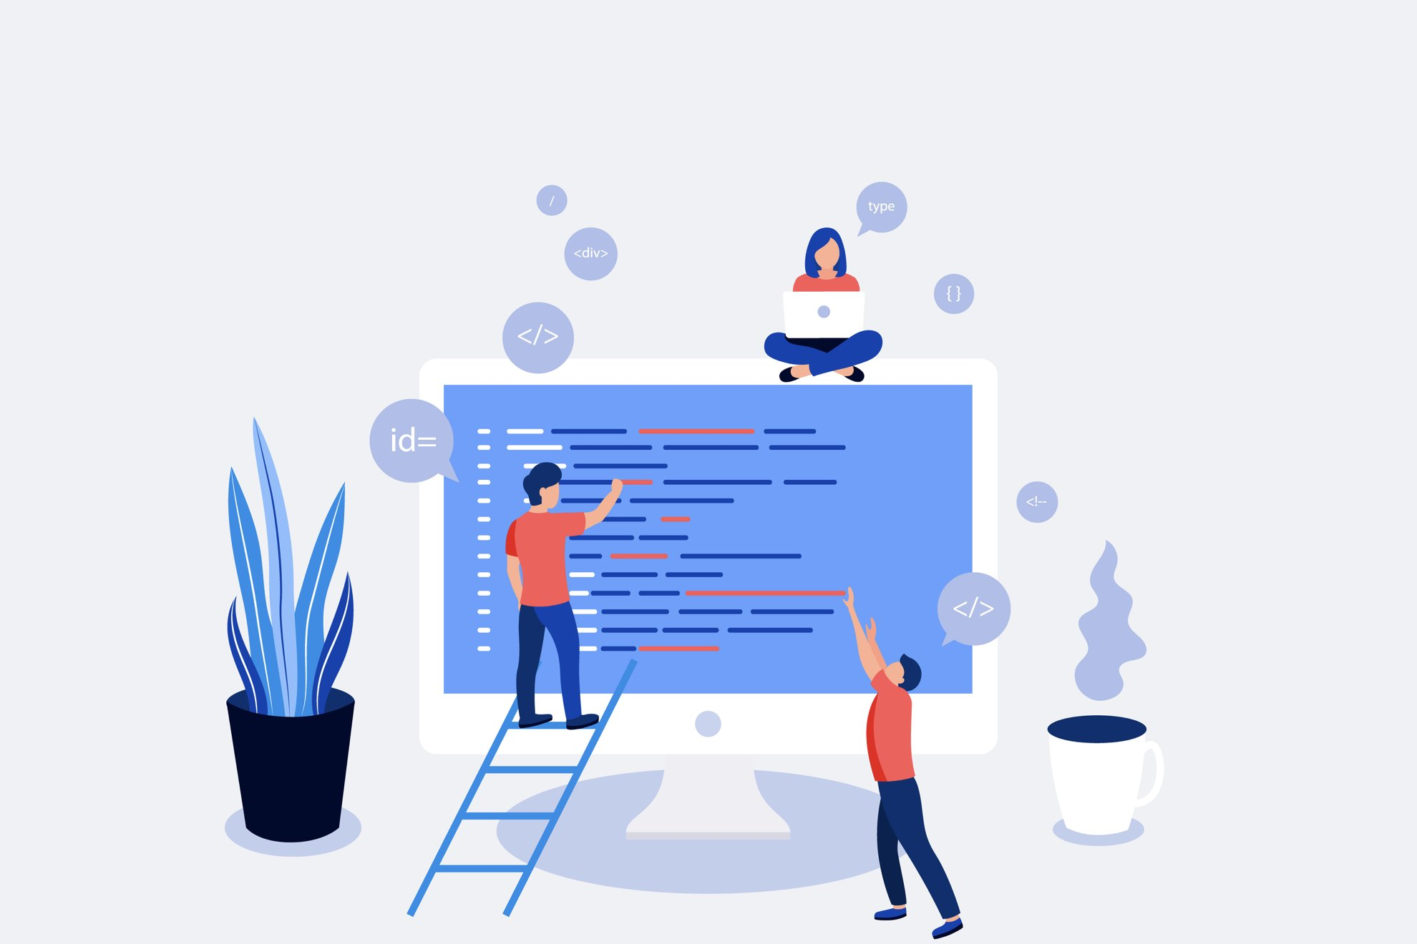

WEB Project
Group 2

Slide 2





Teamwork

Slide 3

Table of contents
Context
Problematic
Guideline and Matrix of rights
Livrable 1 / Livrable 2
Simulation
Conclusion / Prospects for improvement

Slide 4
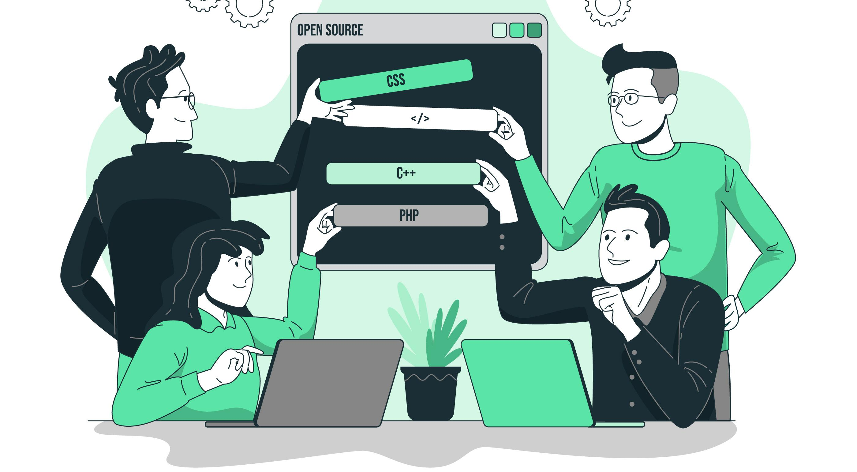
Context
01/19

Slide 5

Problematic
How to design a responsive, role-adaptable web application that can record and display data?
02/19

Slide 6
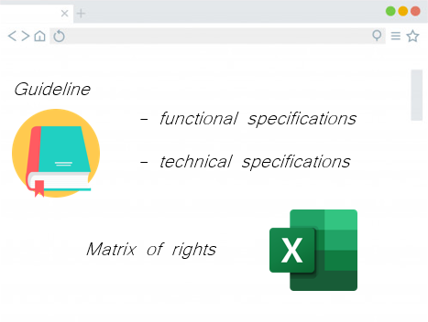
Guideline/ Matrix of rights
03/19

Slide 7
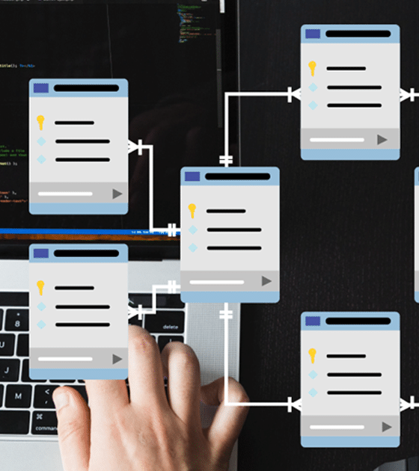
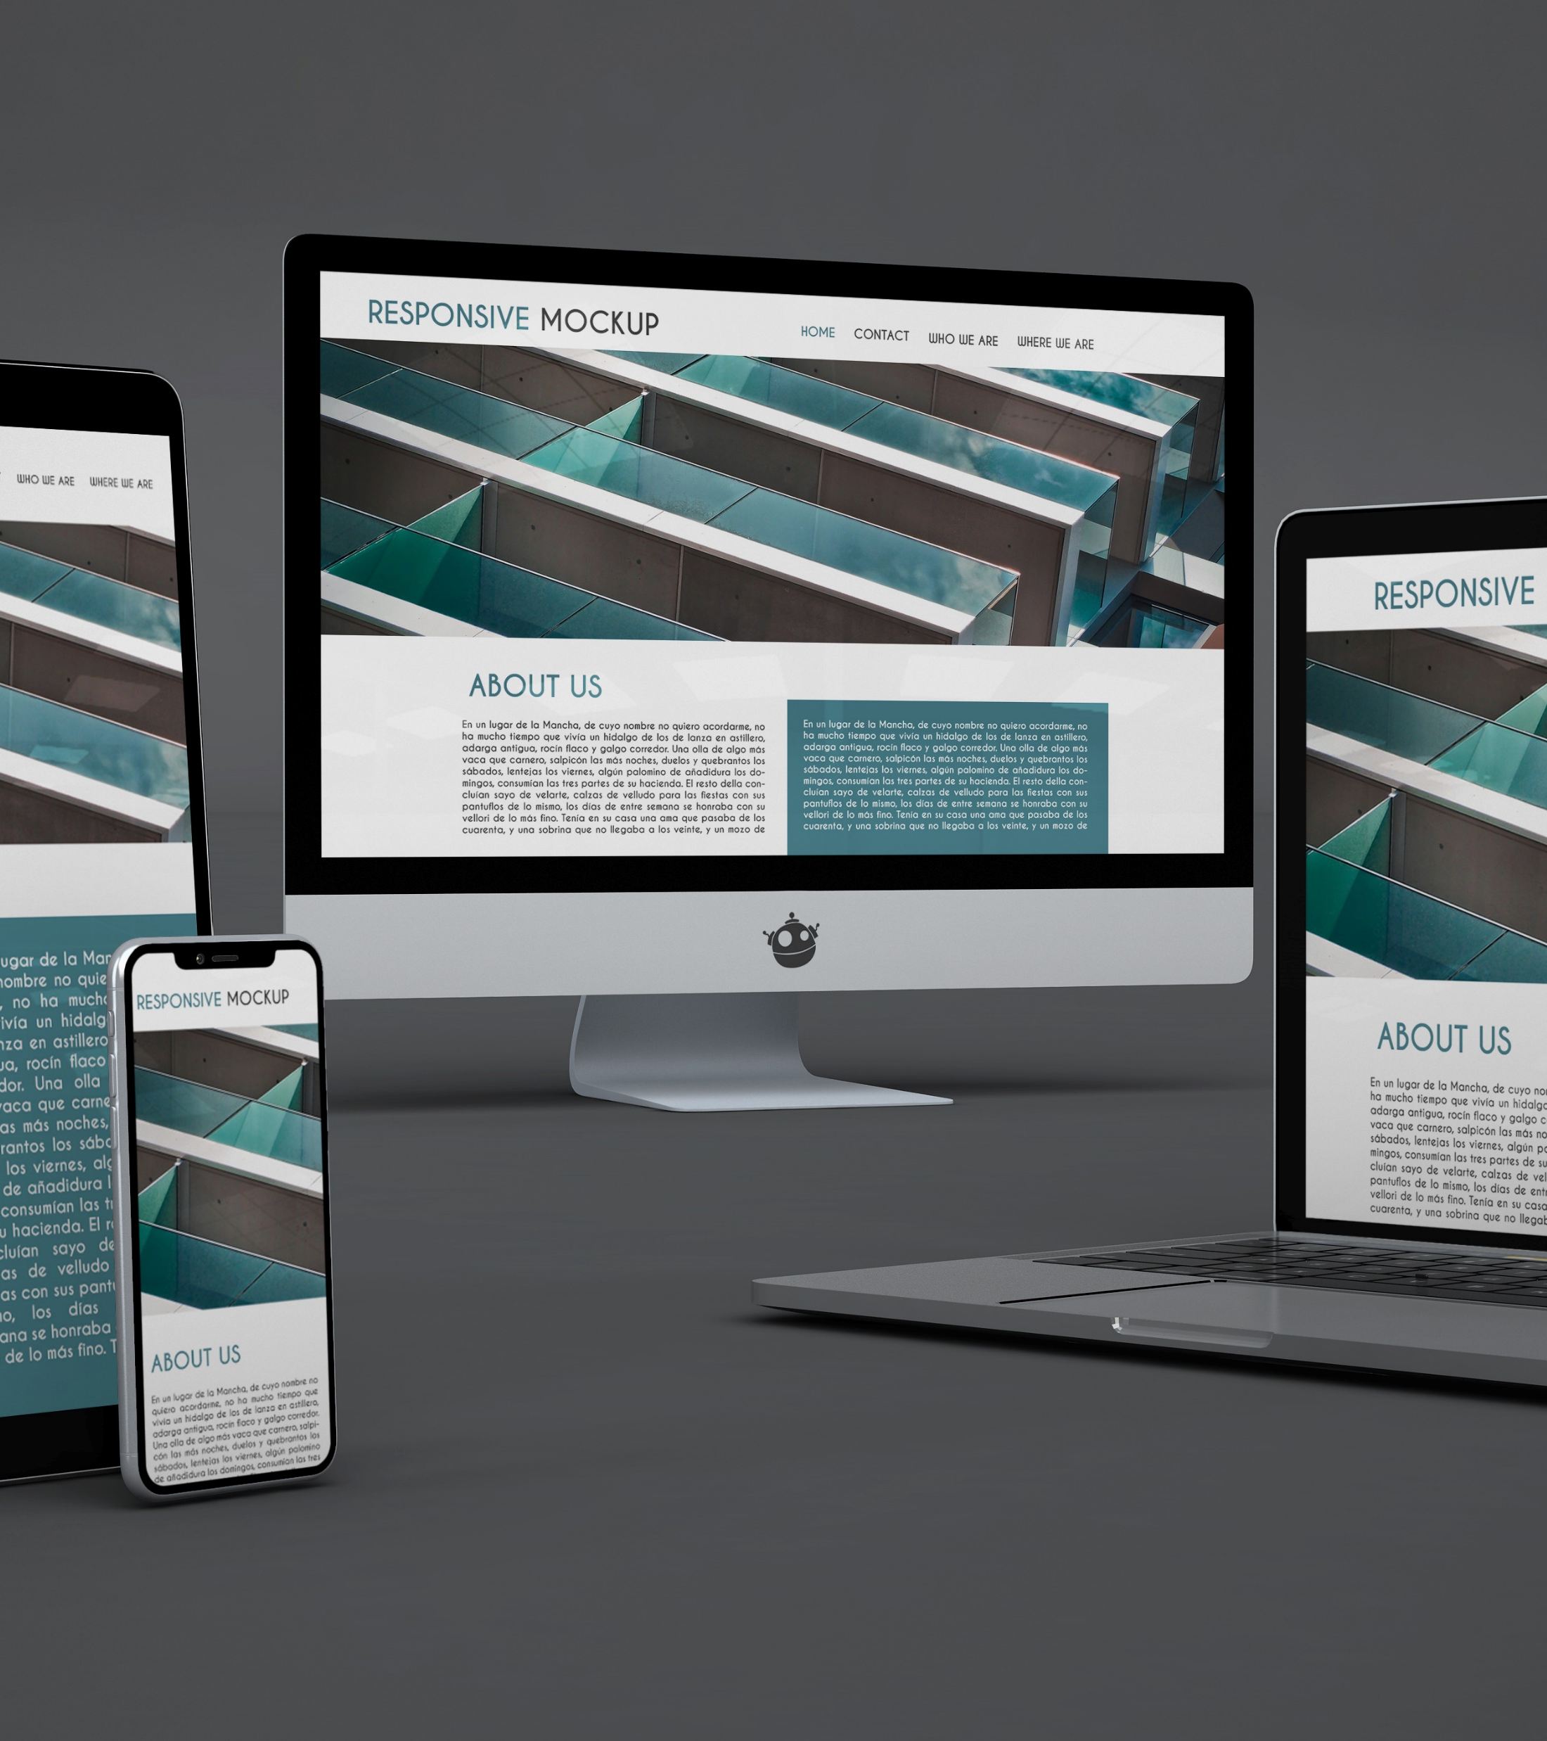
Livrable 1
04/19
Notes:
Design and ideas of our website
Conception of our data base

Slide 8
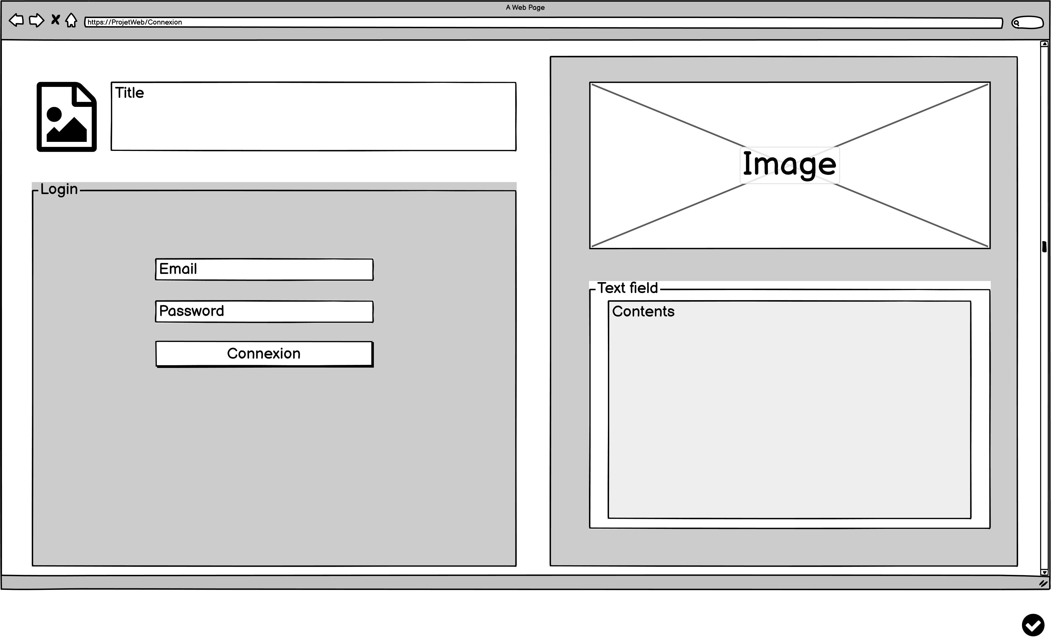
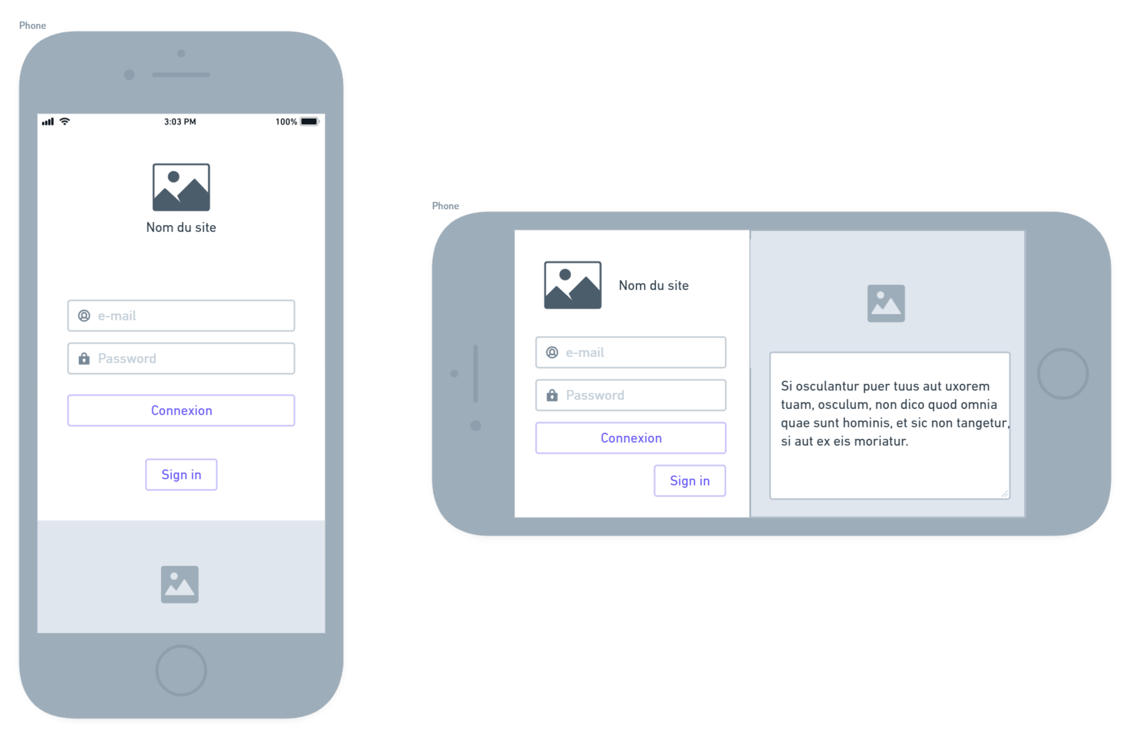
Mock-up : Login
05/19

Slide 9
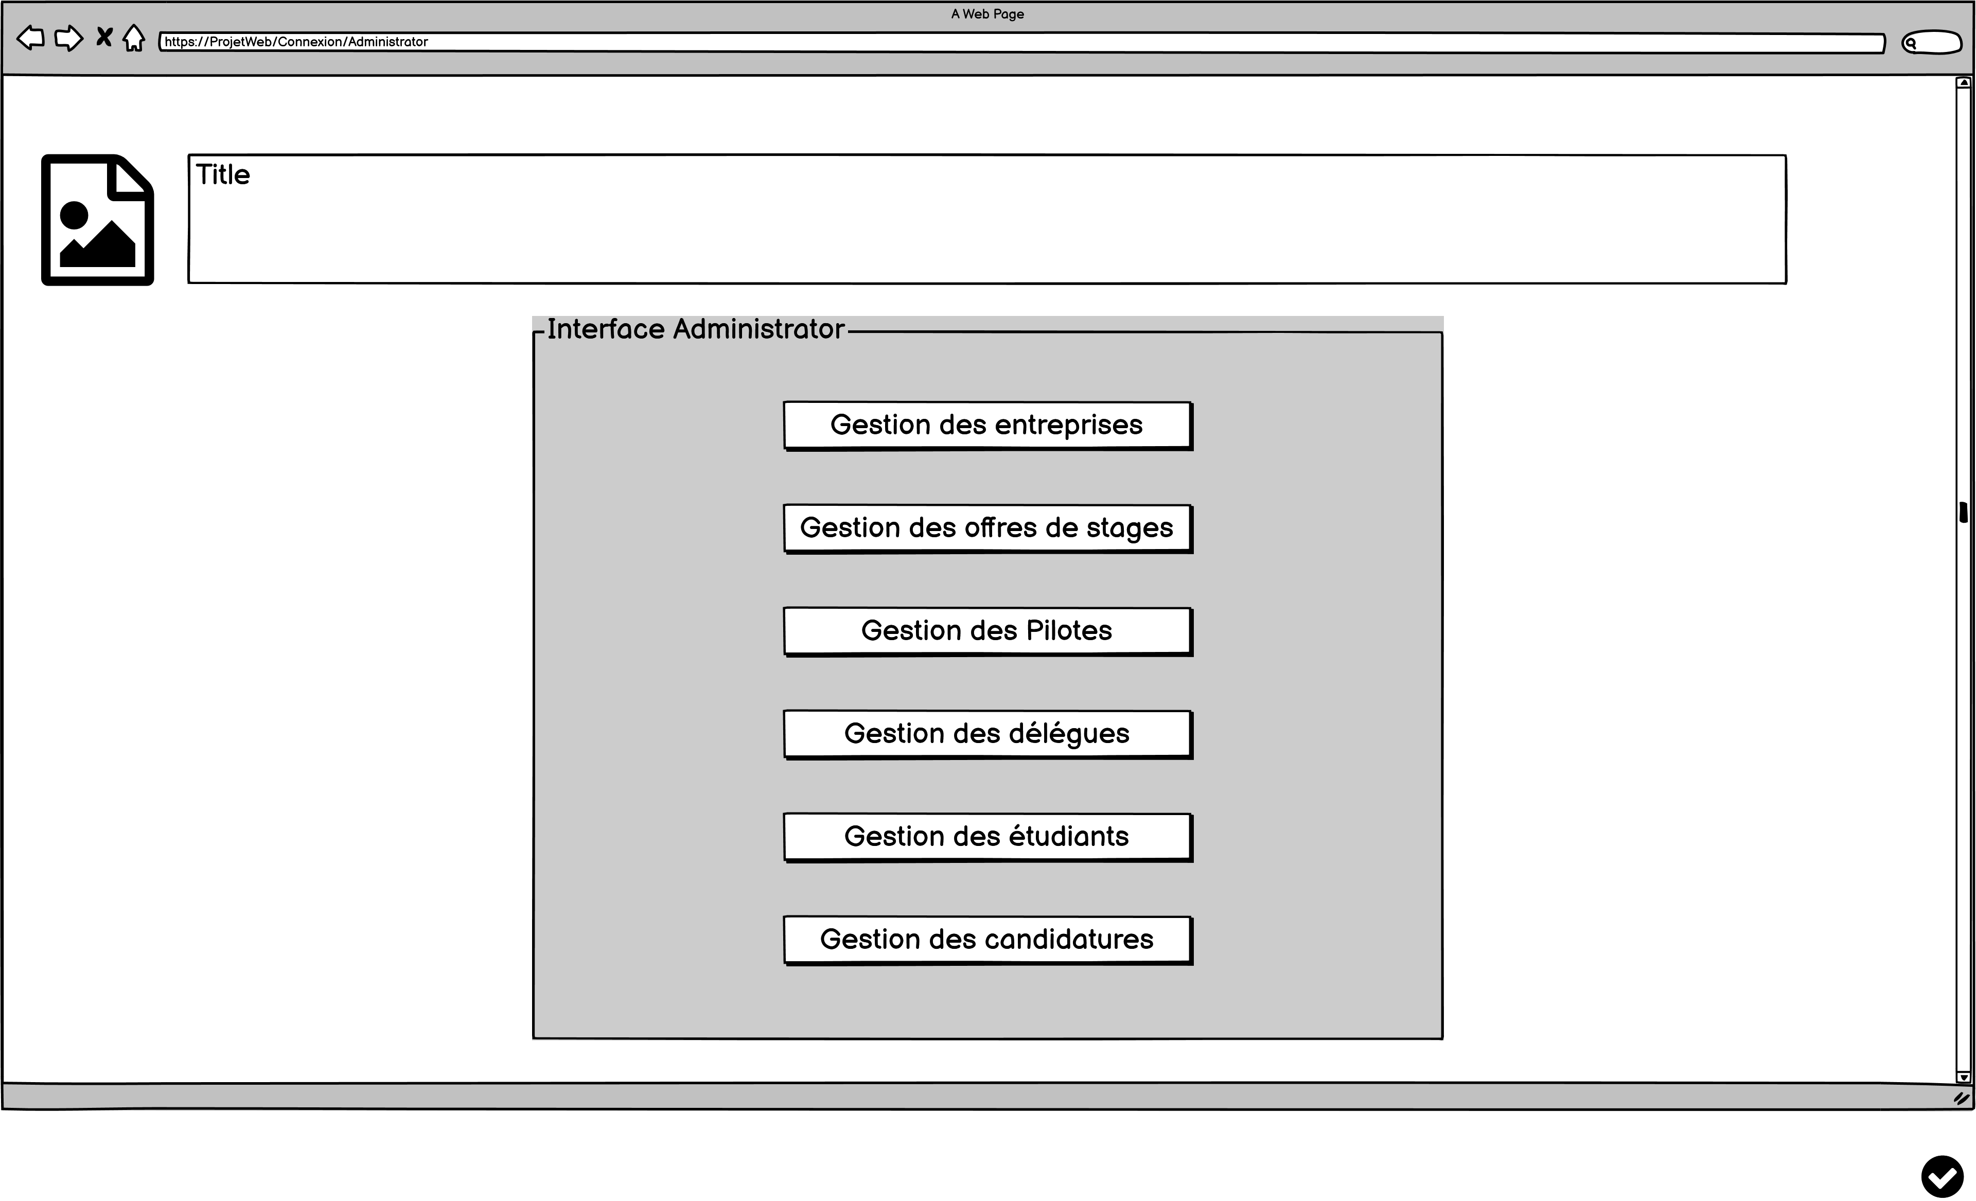
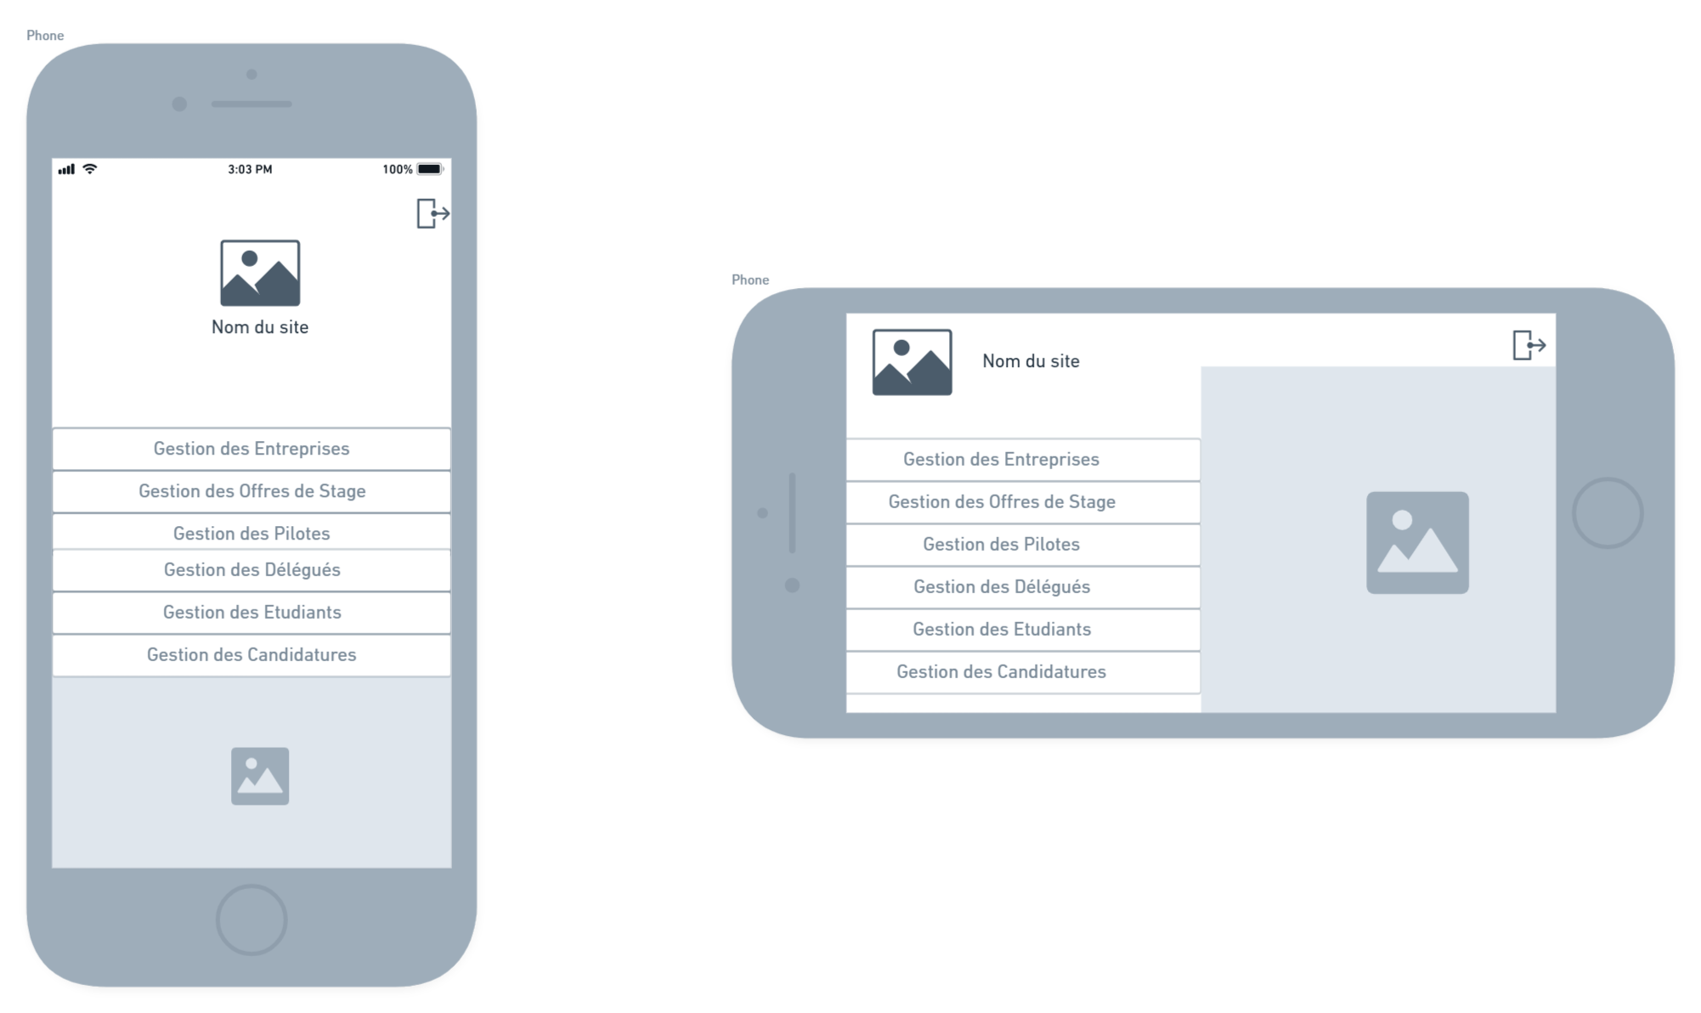
Livrable 1 : Administrator
06/19

Slide 10
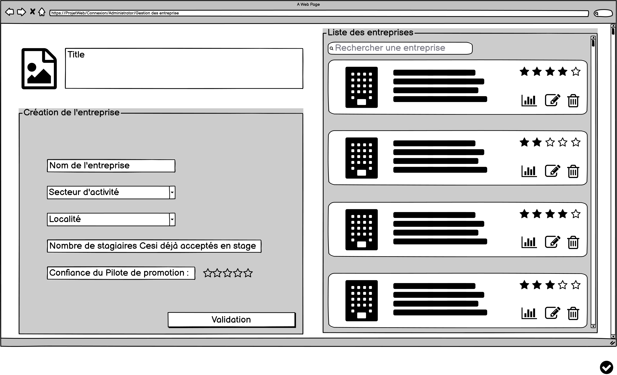
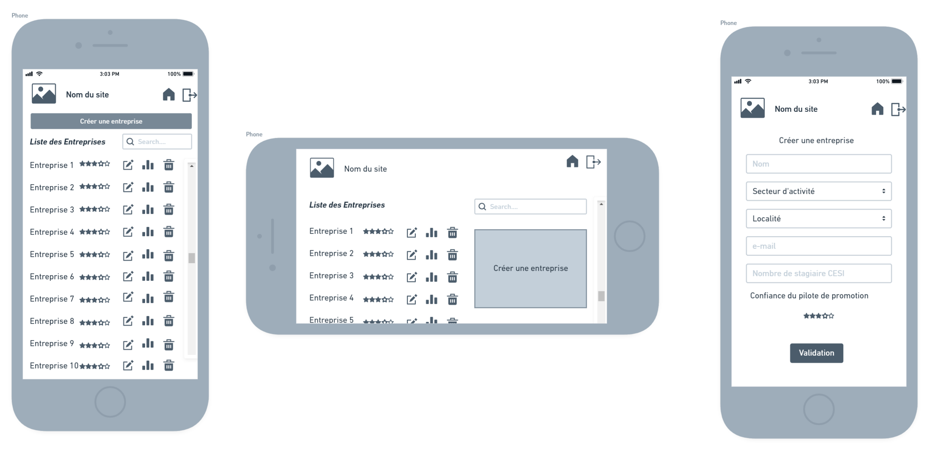
Mock-up : Compagny management
07/19

Slide 11
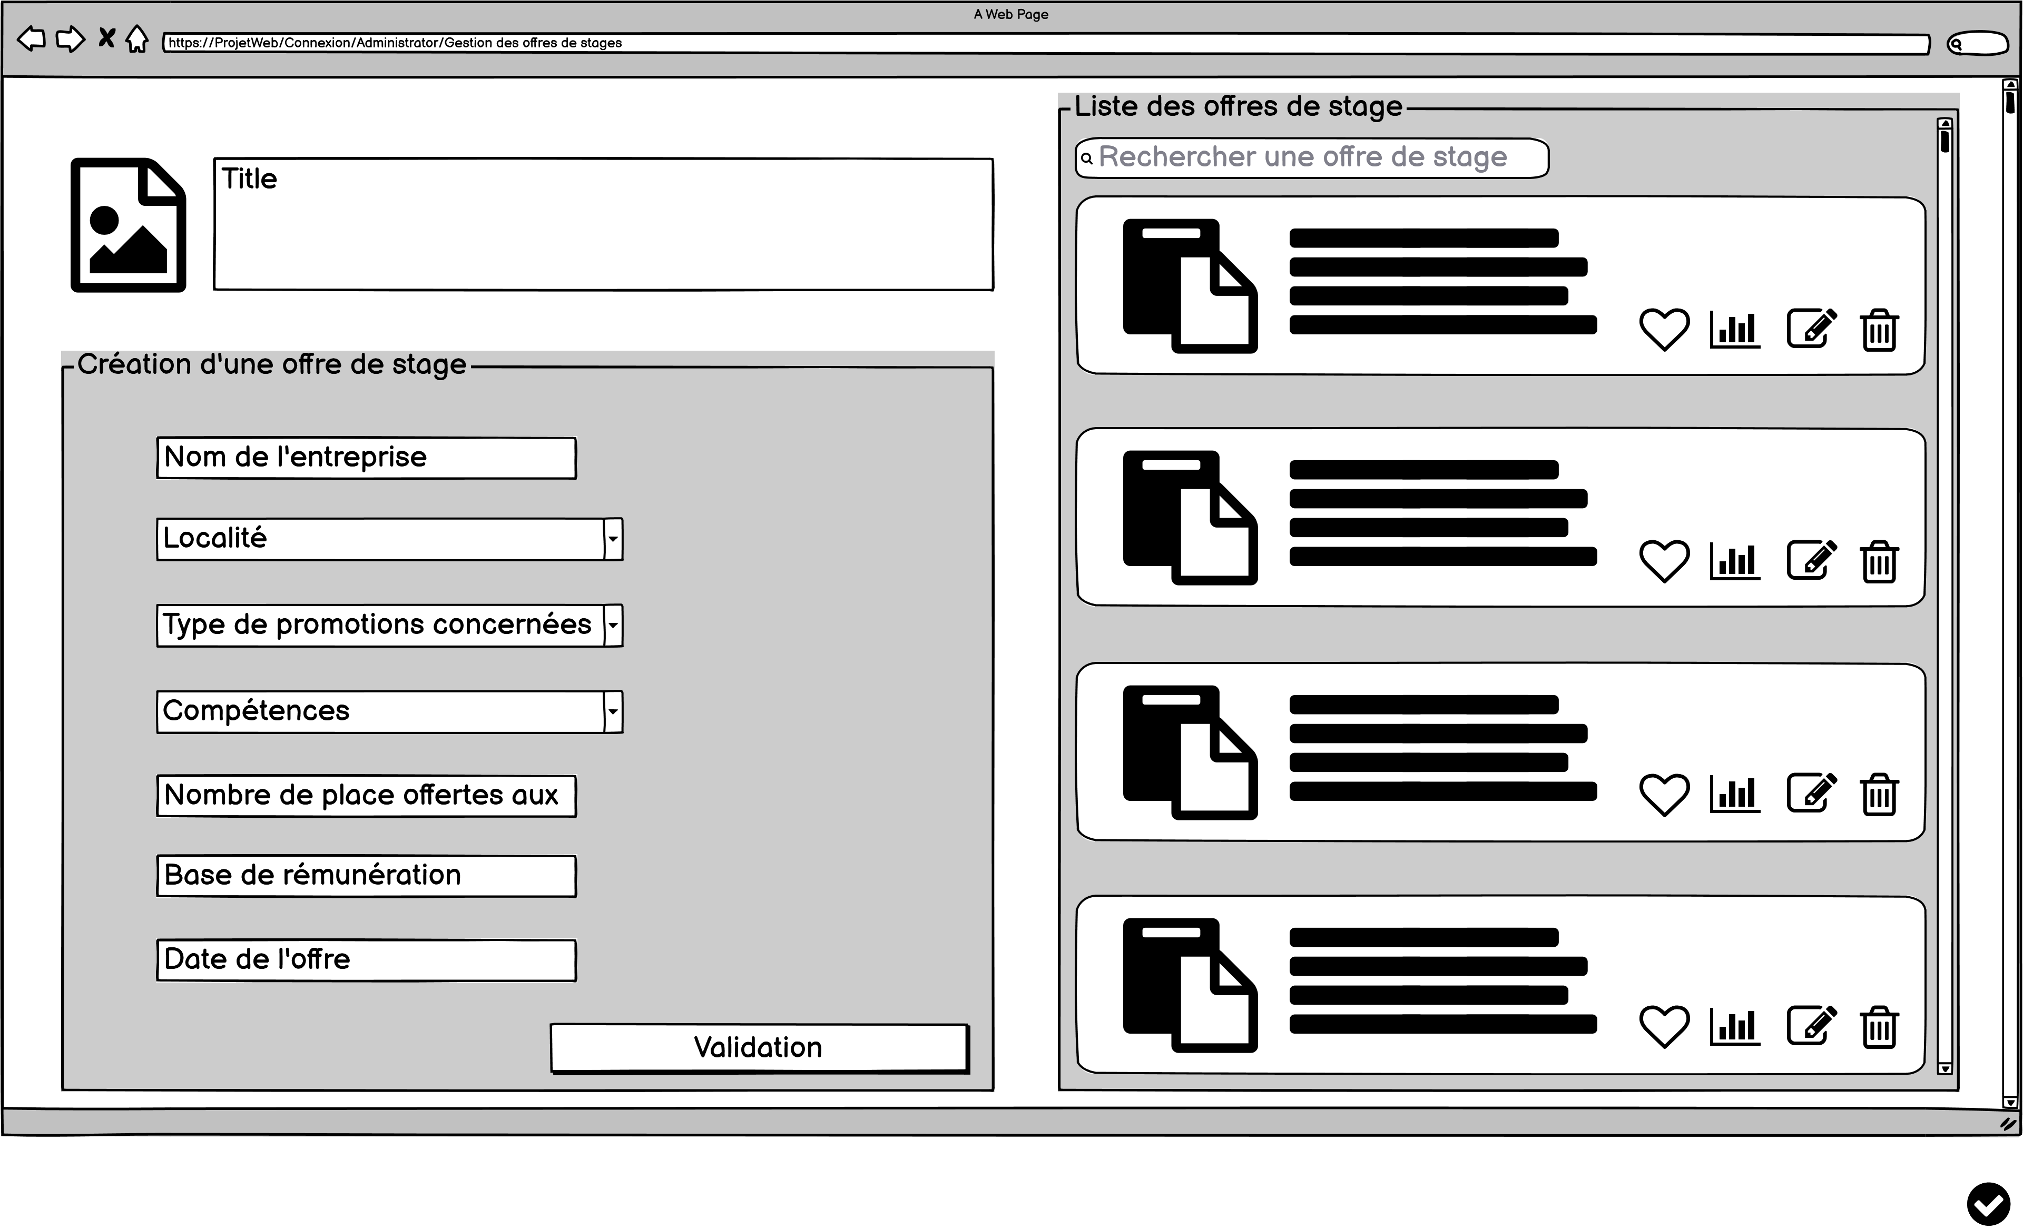
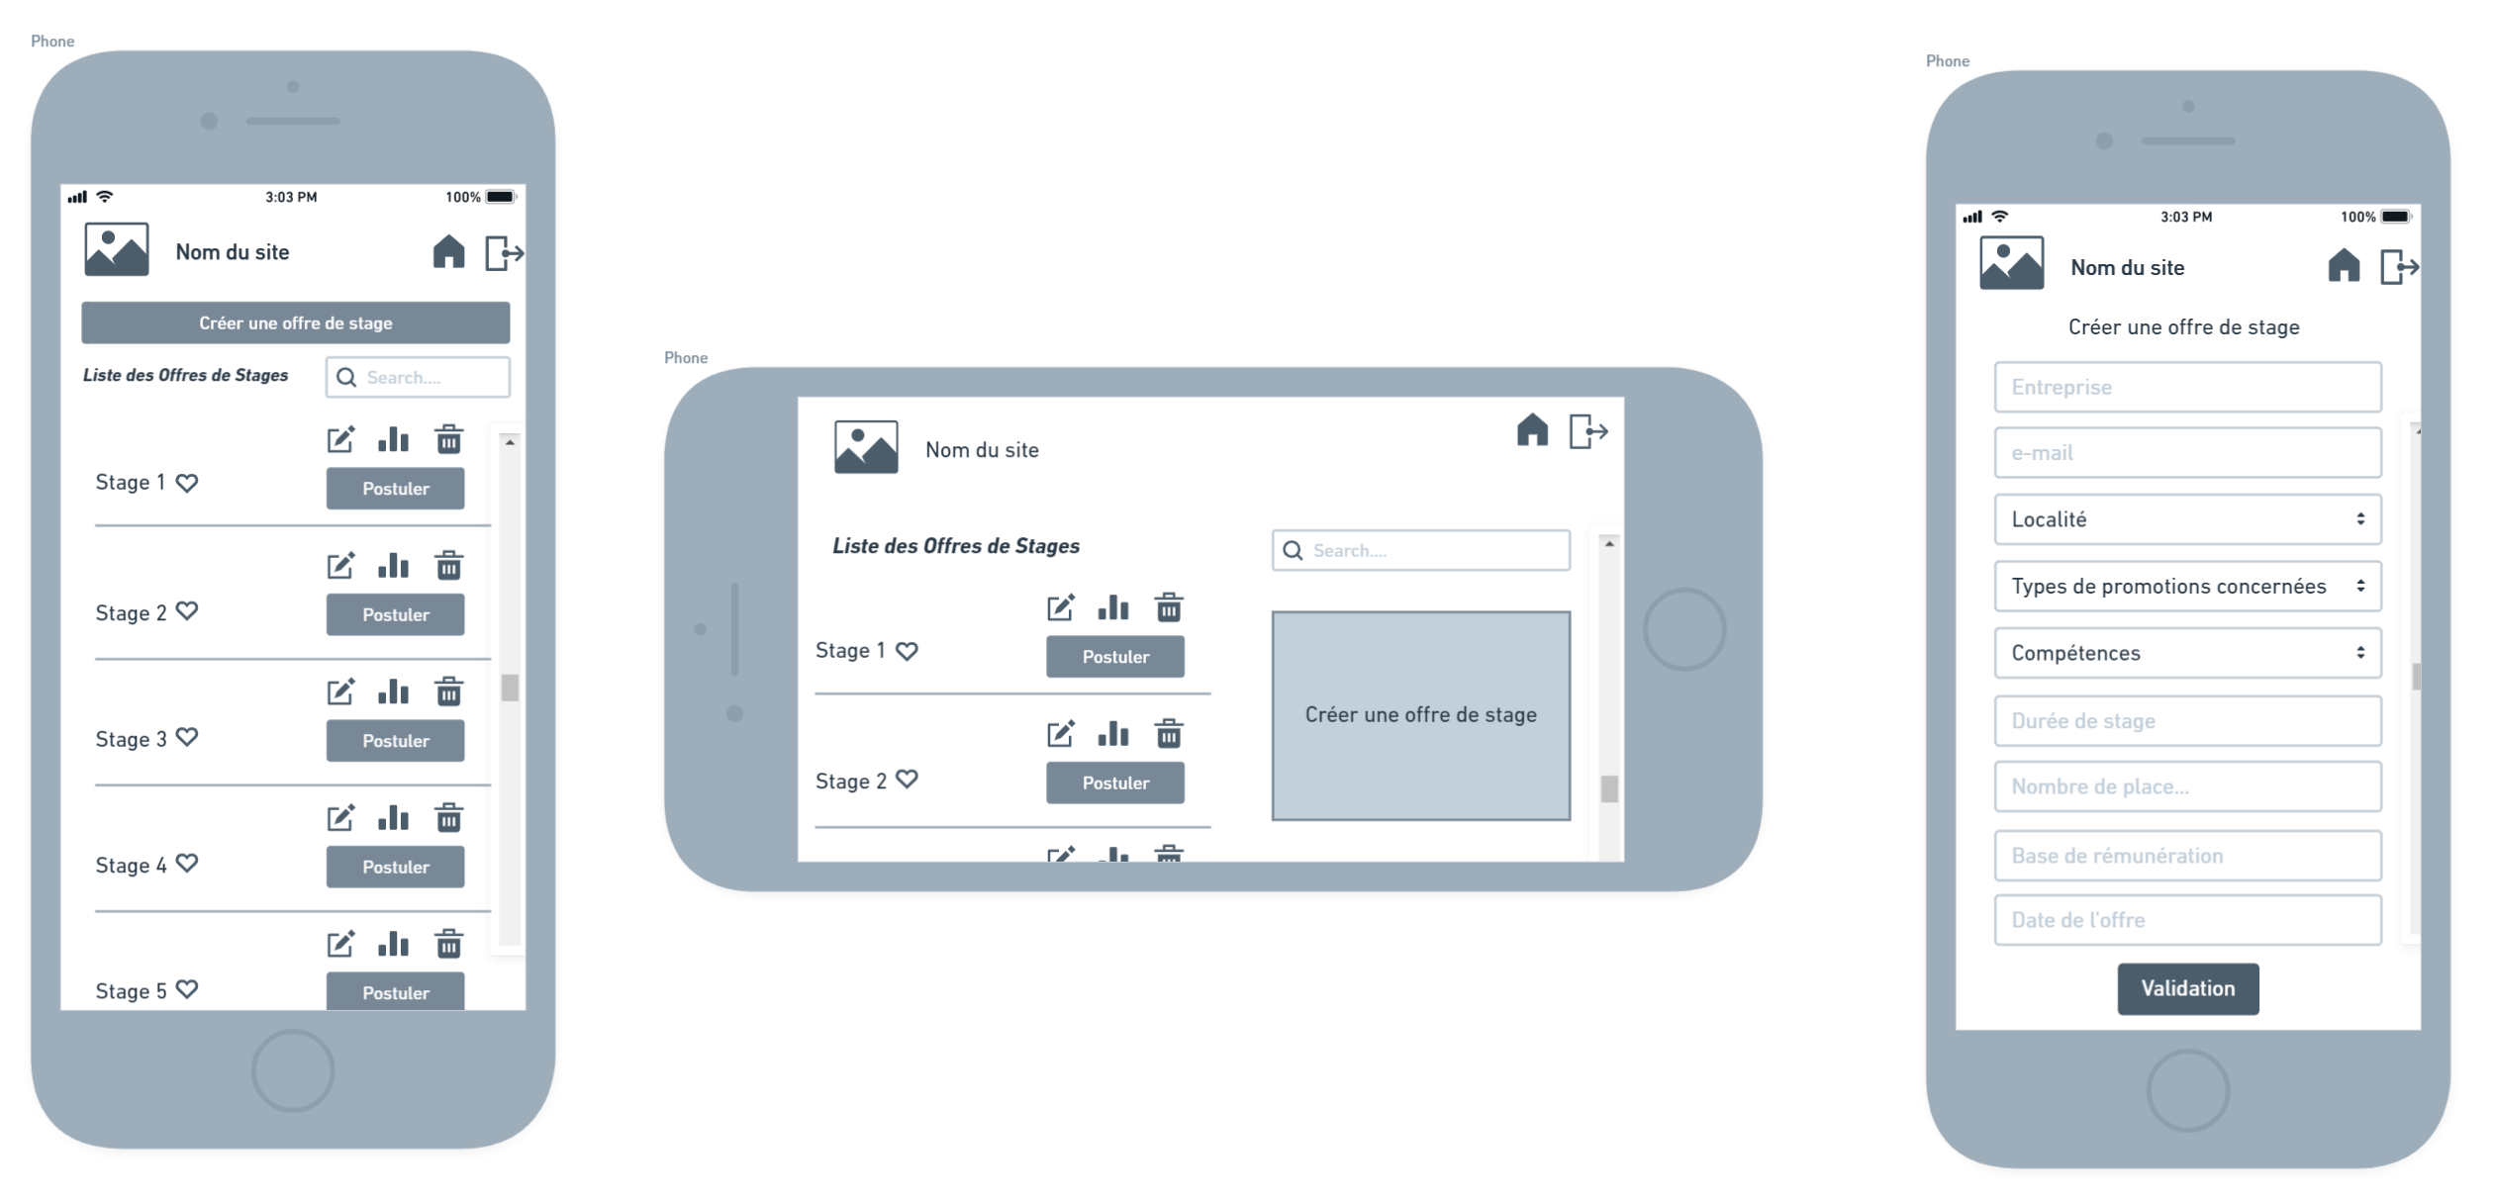
Livrable 1 : Internships management
08/19

Slide 12
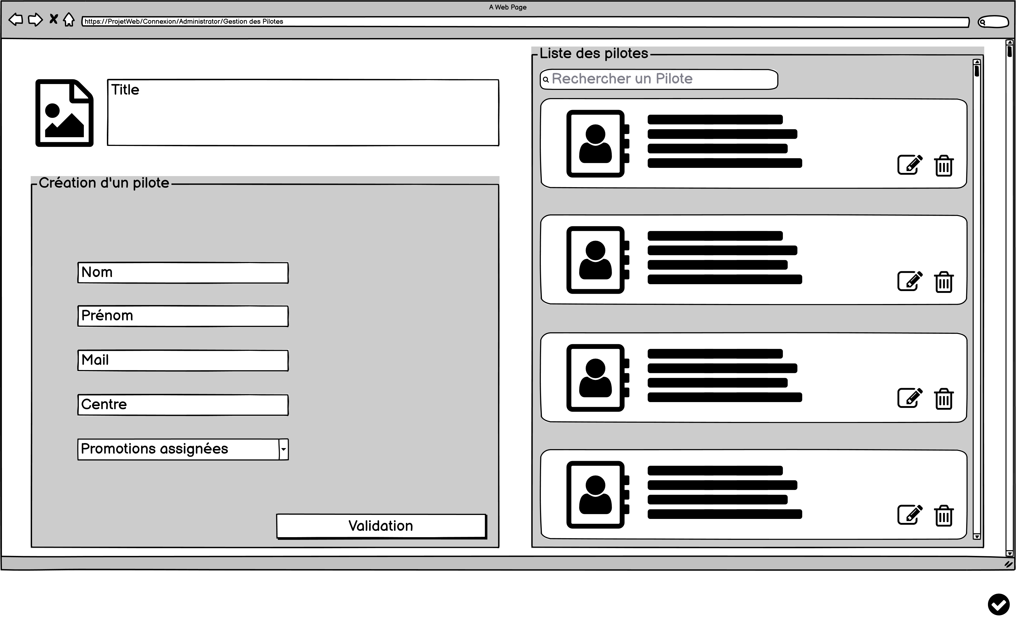
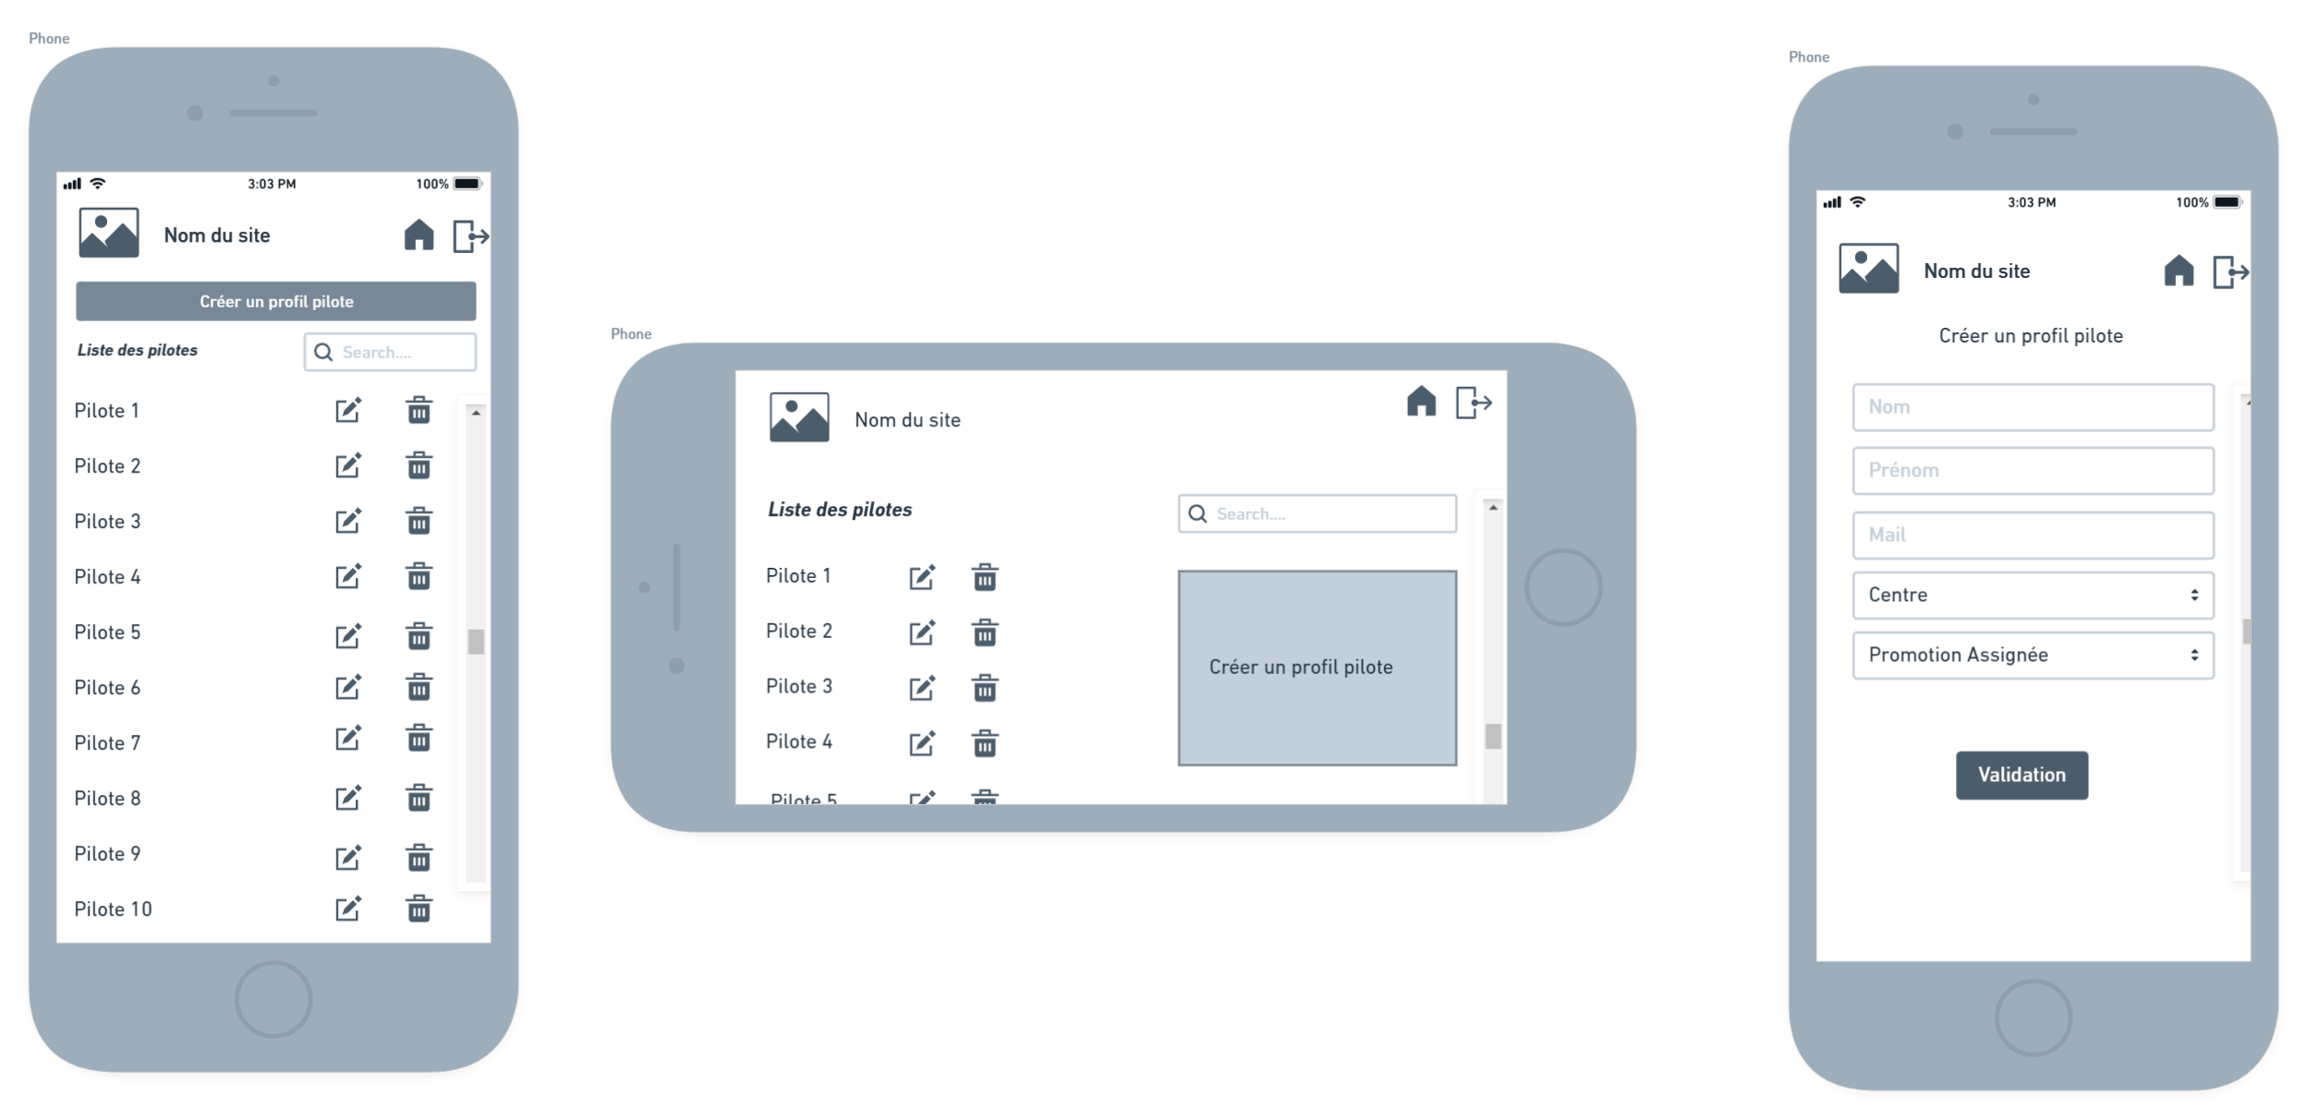
Mock-up : Pilotes management
09/19

Slide 13
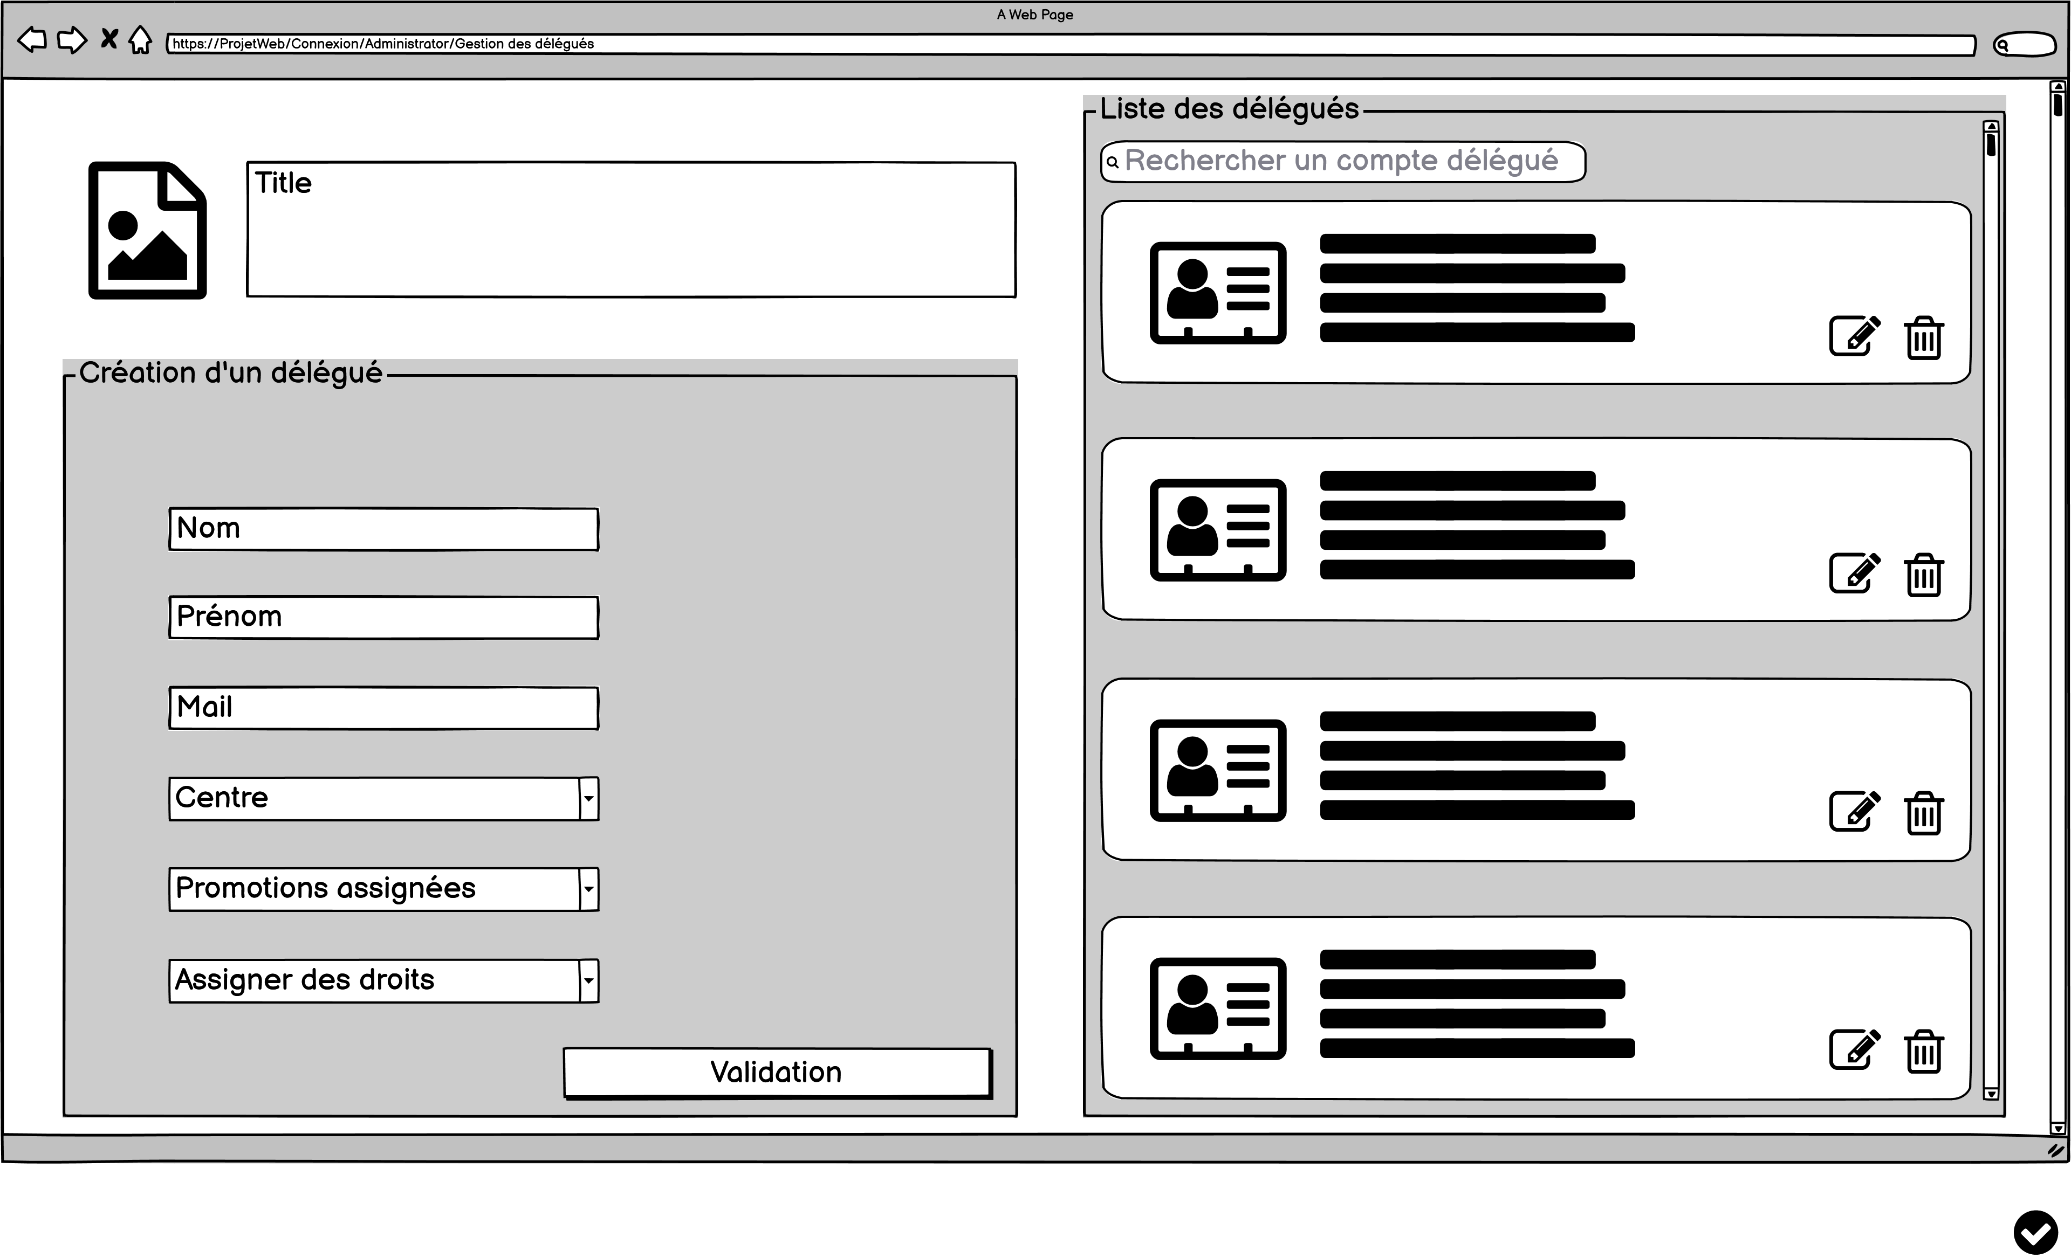
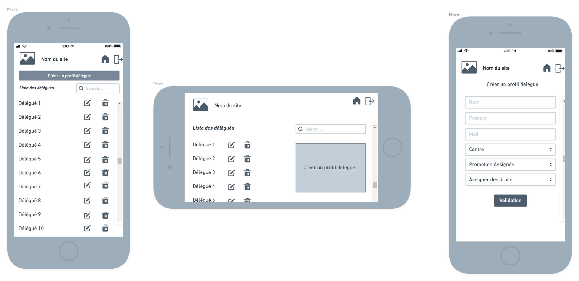
Mock-up : Class representatives management
10/19

Slide 14
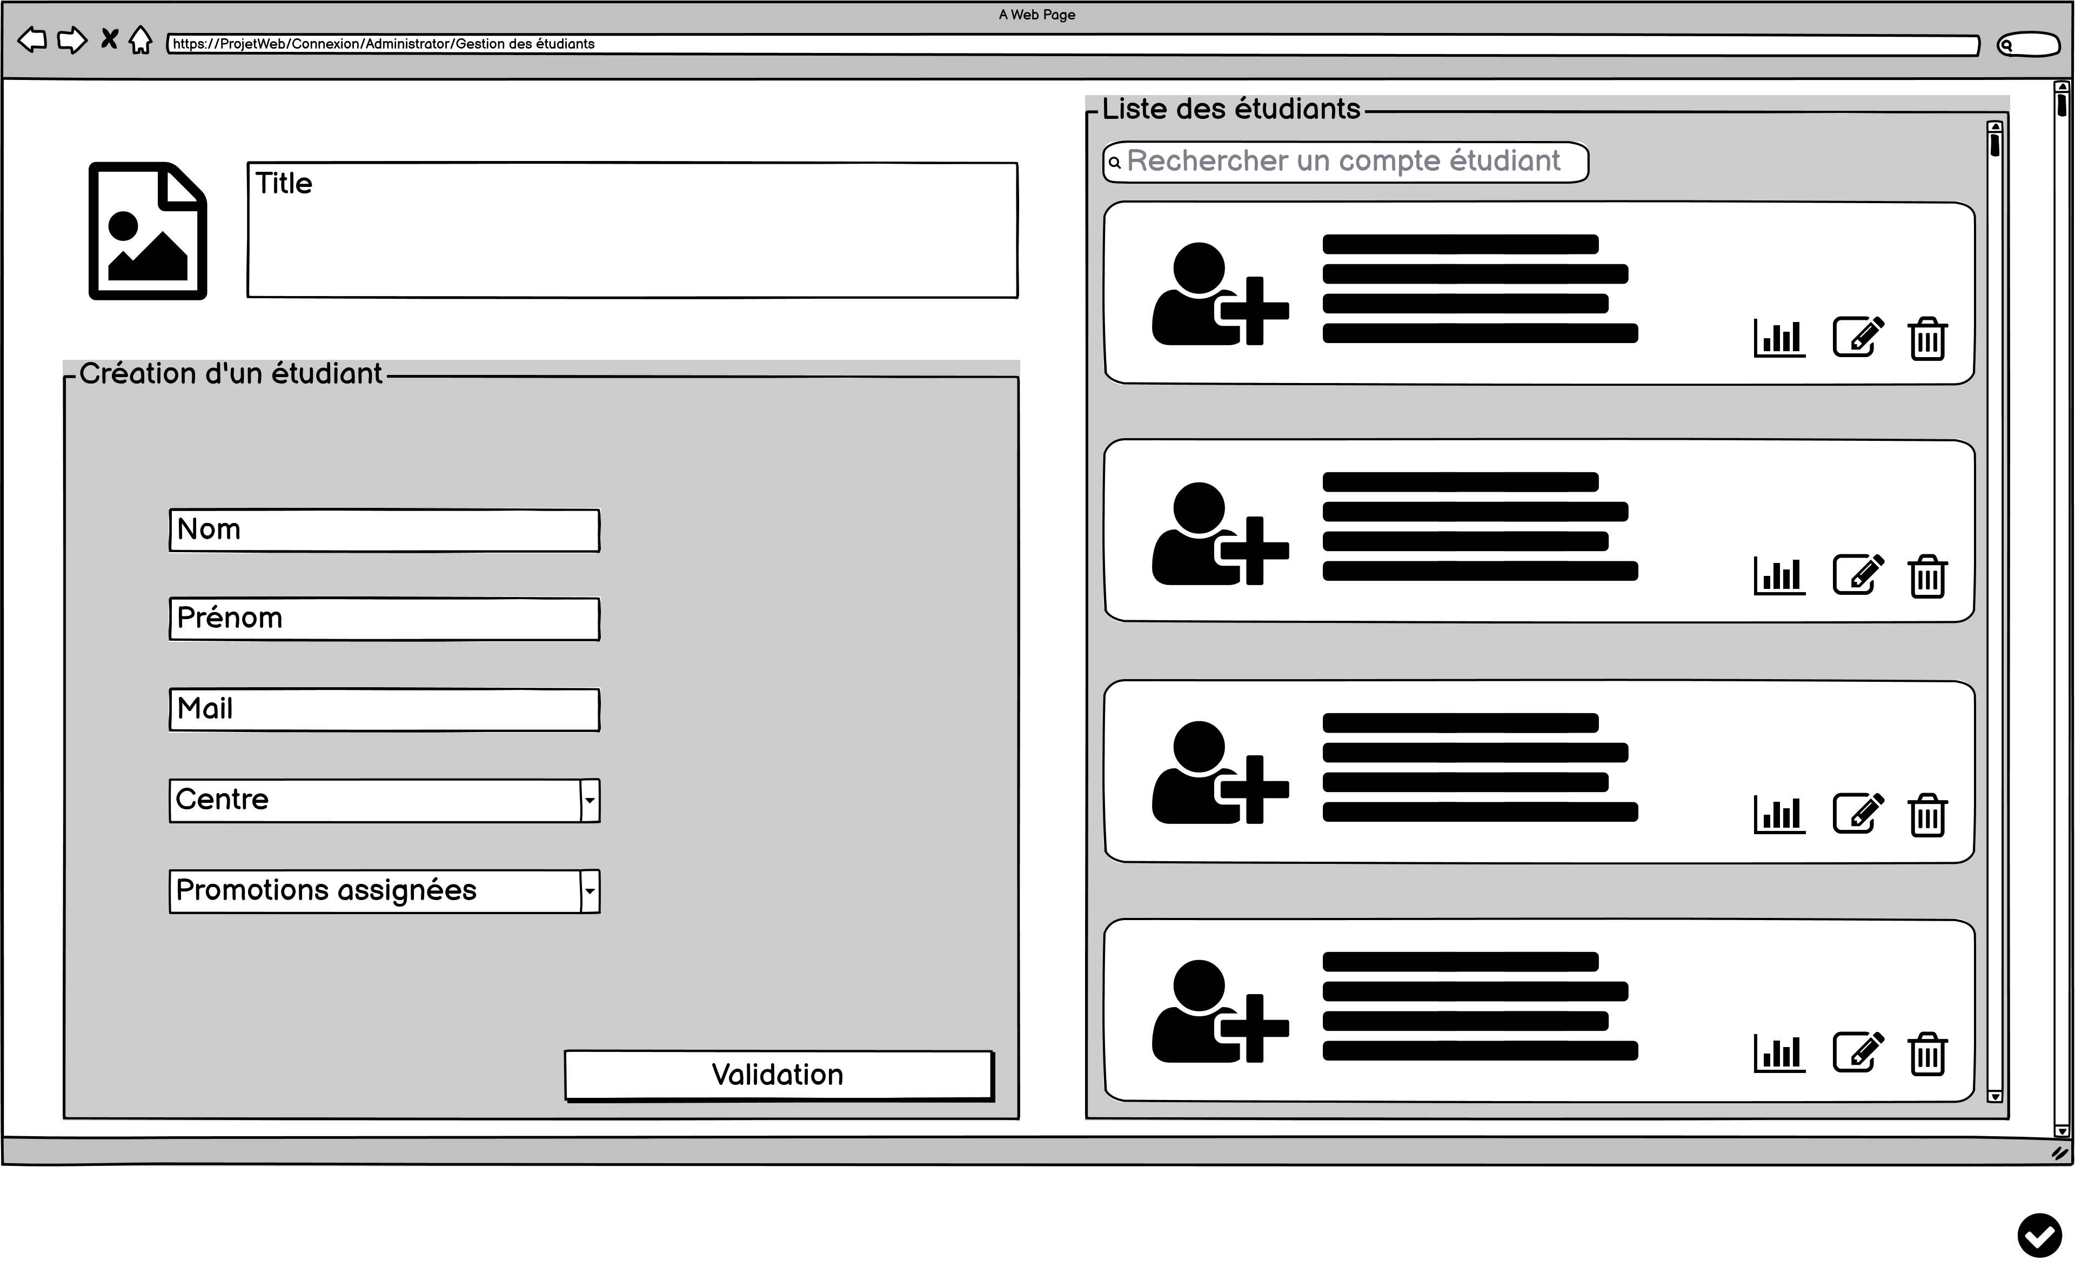
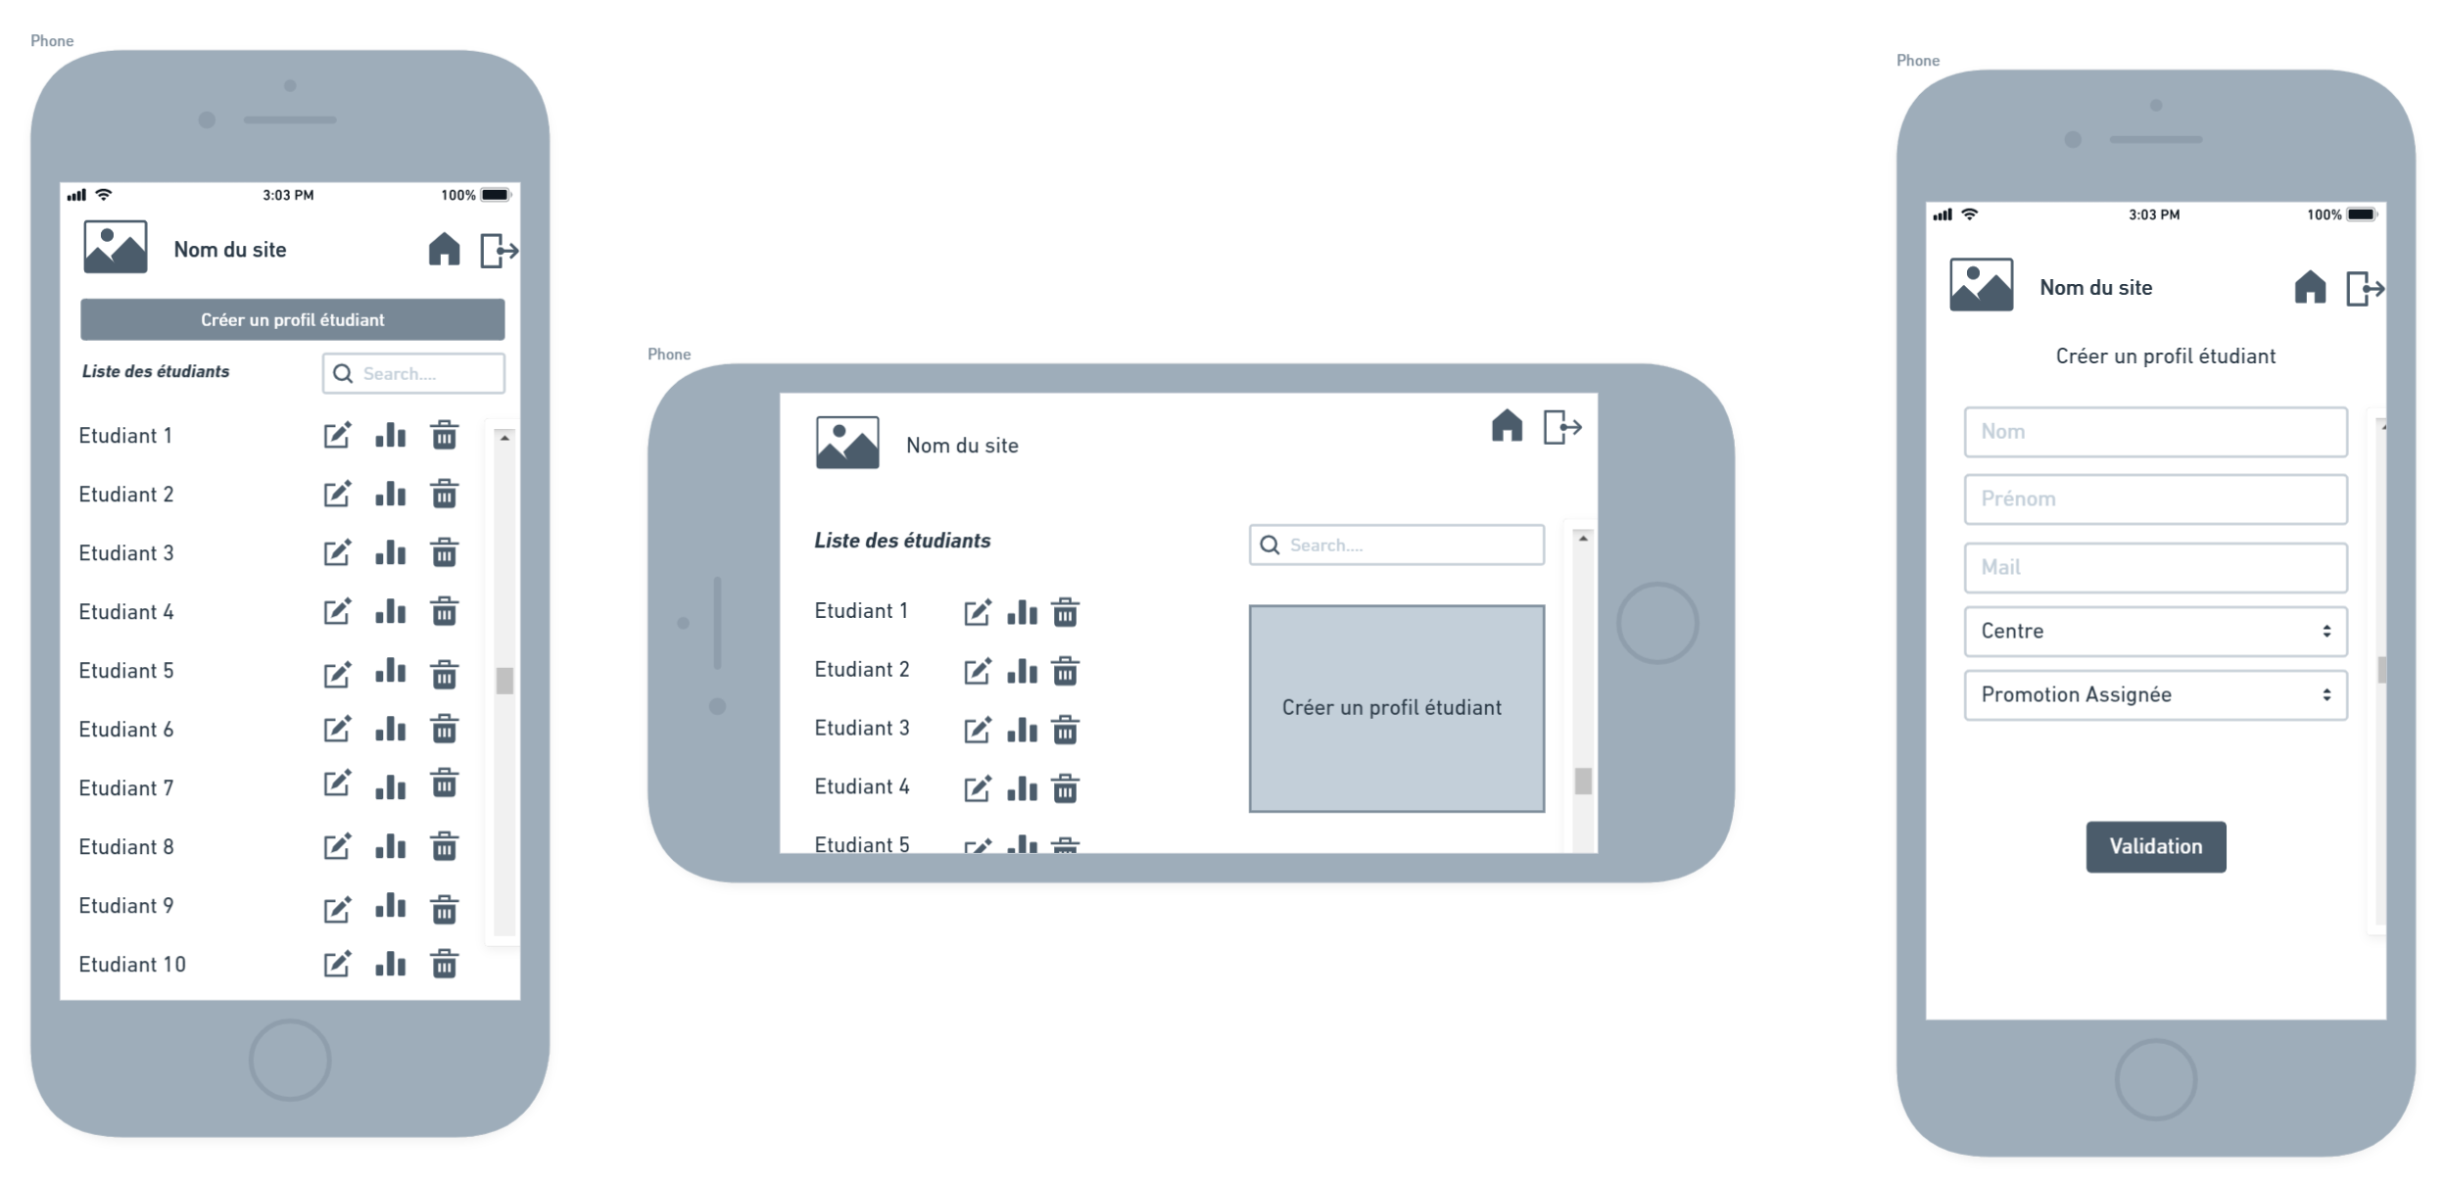
Mock-up : Students management
11/19

Slide 15
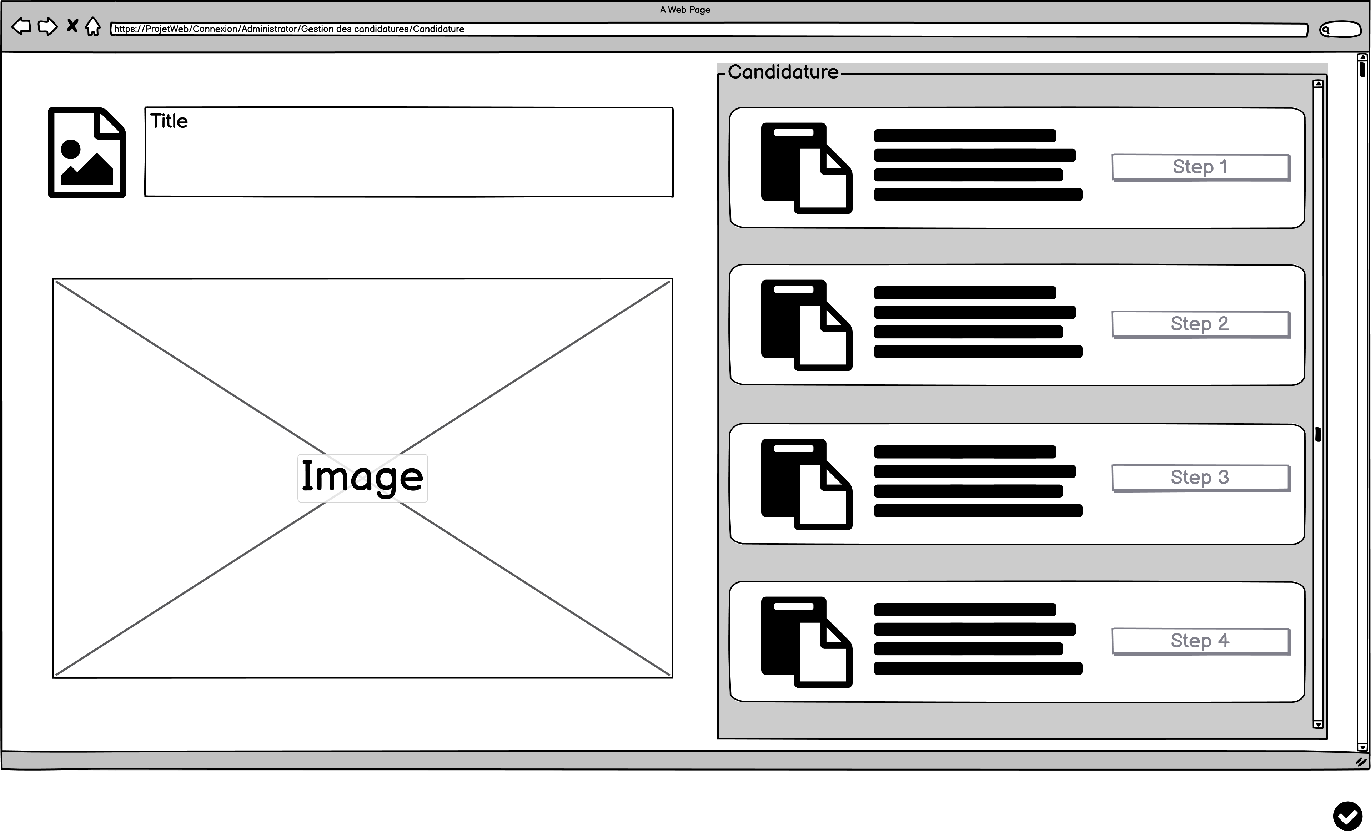
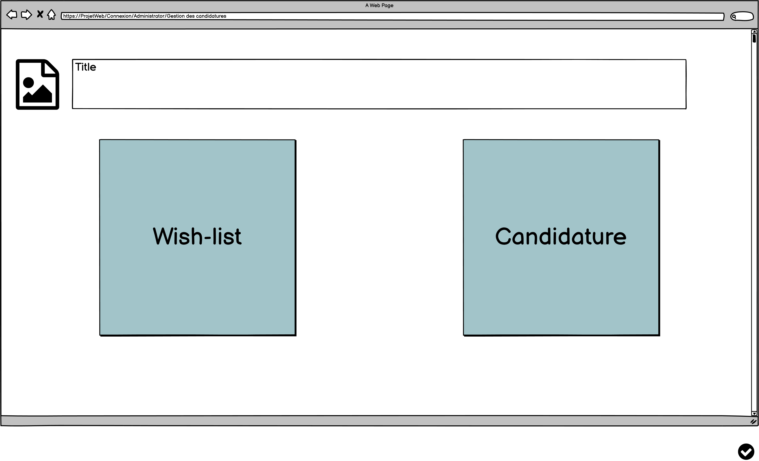
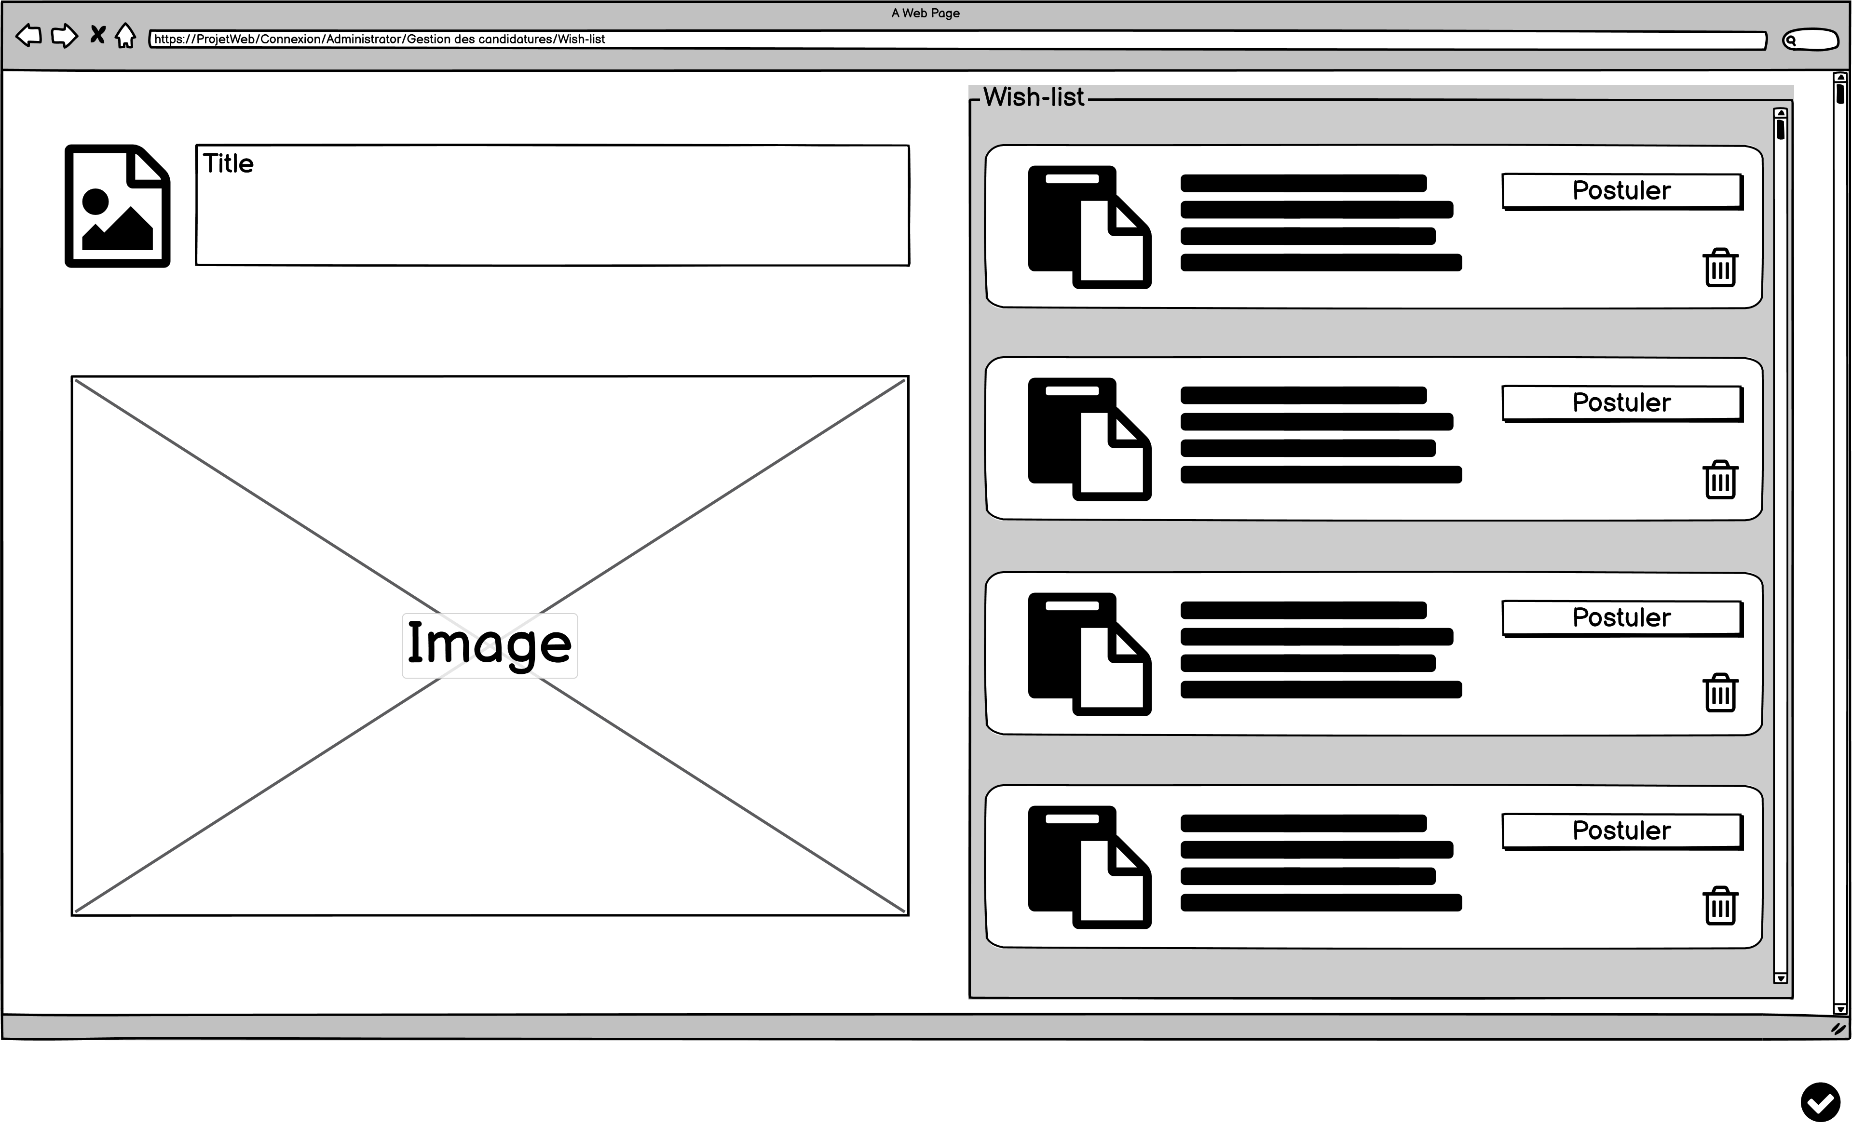
Mock-up : Applications management
12/19

Slide 16
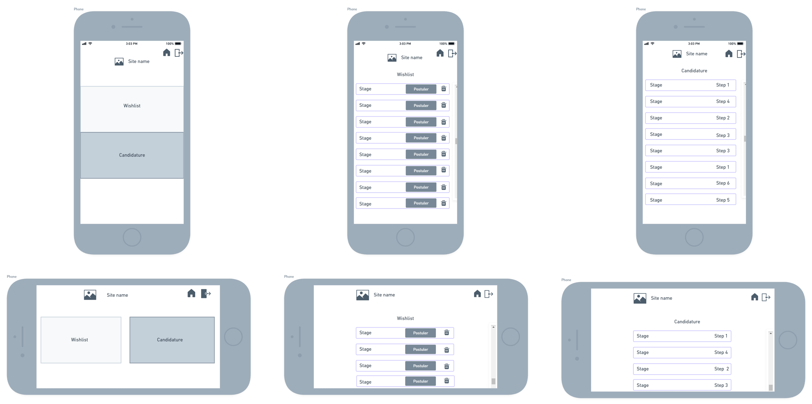
Mock-up : Applications management
13/19

Slide 17
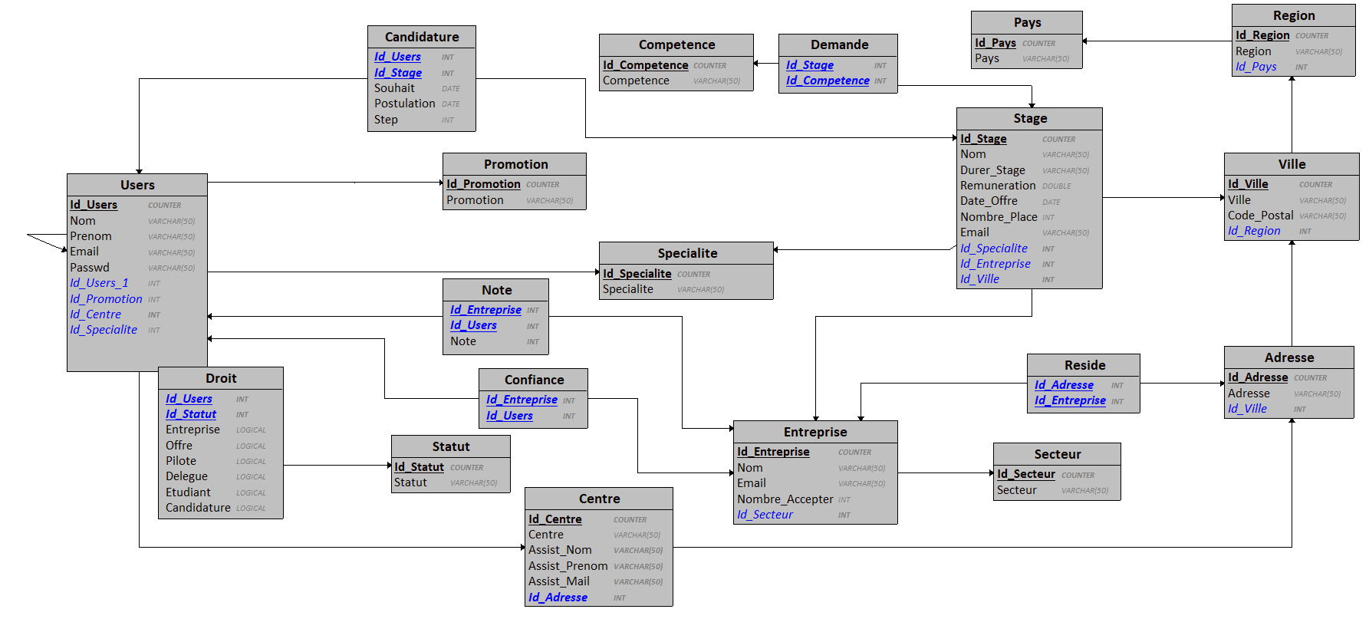
Logical Data Model :
14/19

Slide 18


Livrable 2
15/19

Slide 19
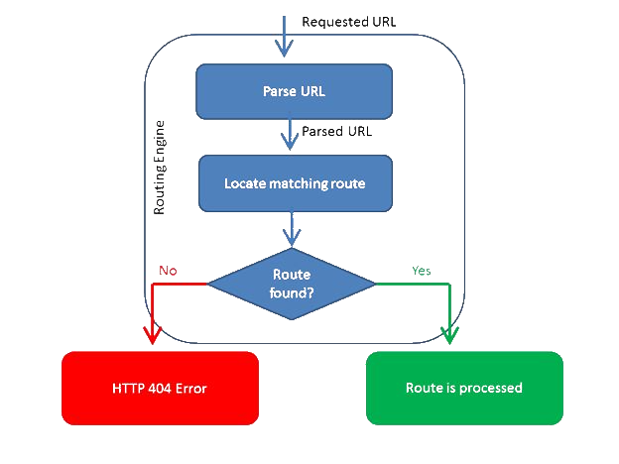
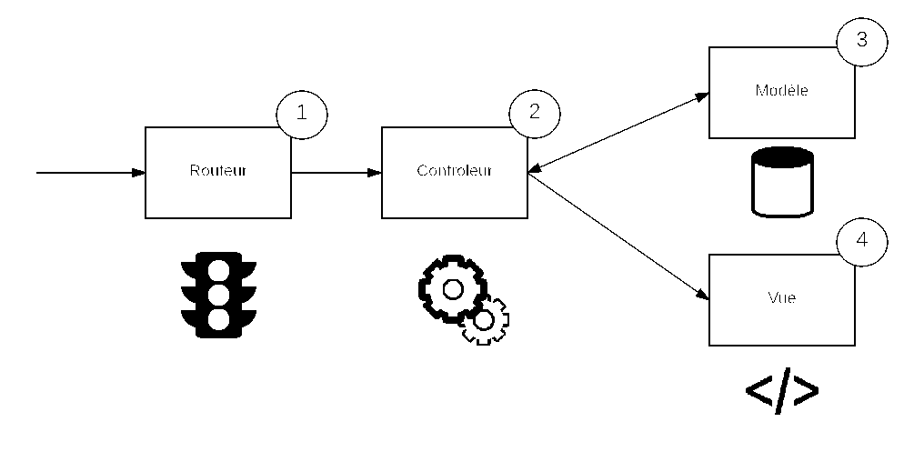
Model view controler structure
model
router
controler
view
http error 404
Route is processed
16/19

Slide 20
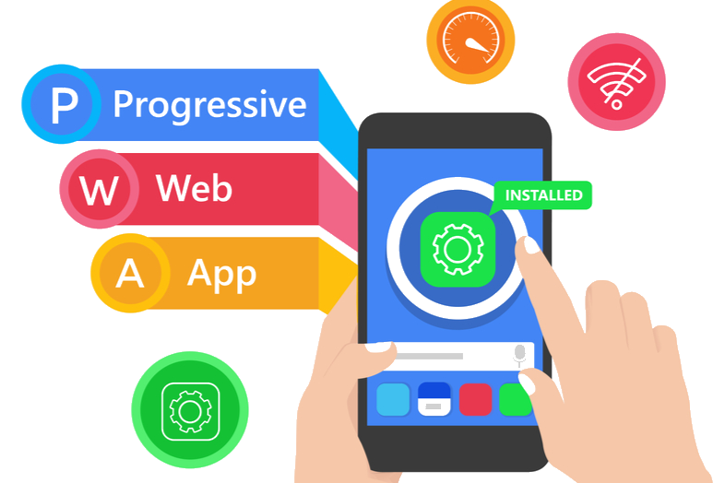
Progressive web application
17/19

Slide 21

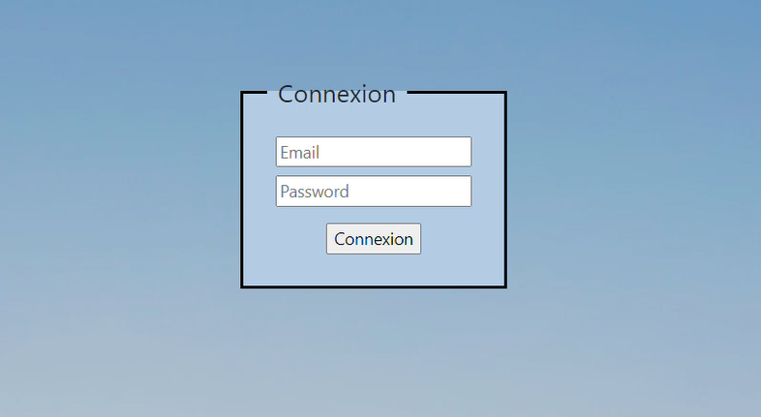
Simulation
18/19

Slide 22
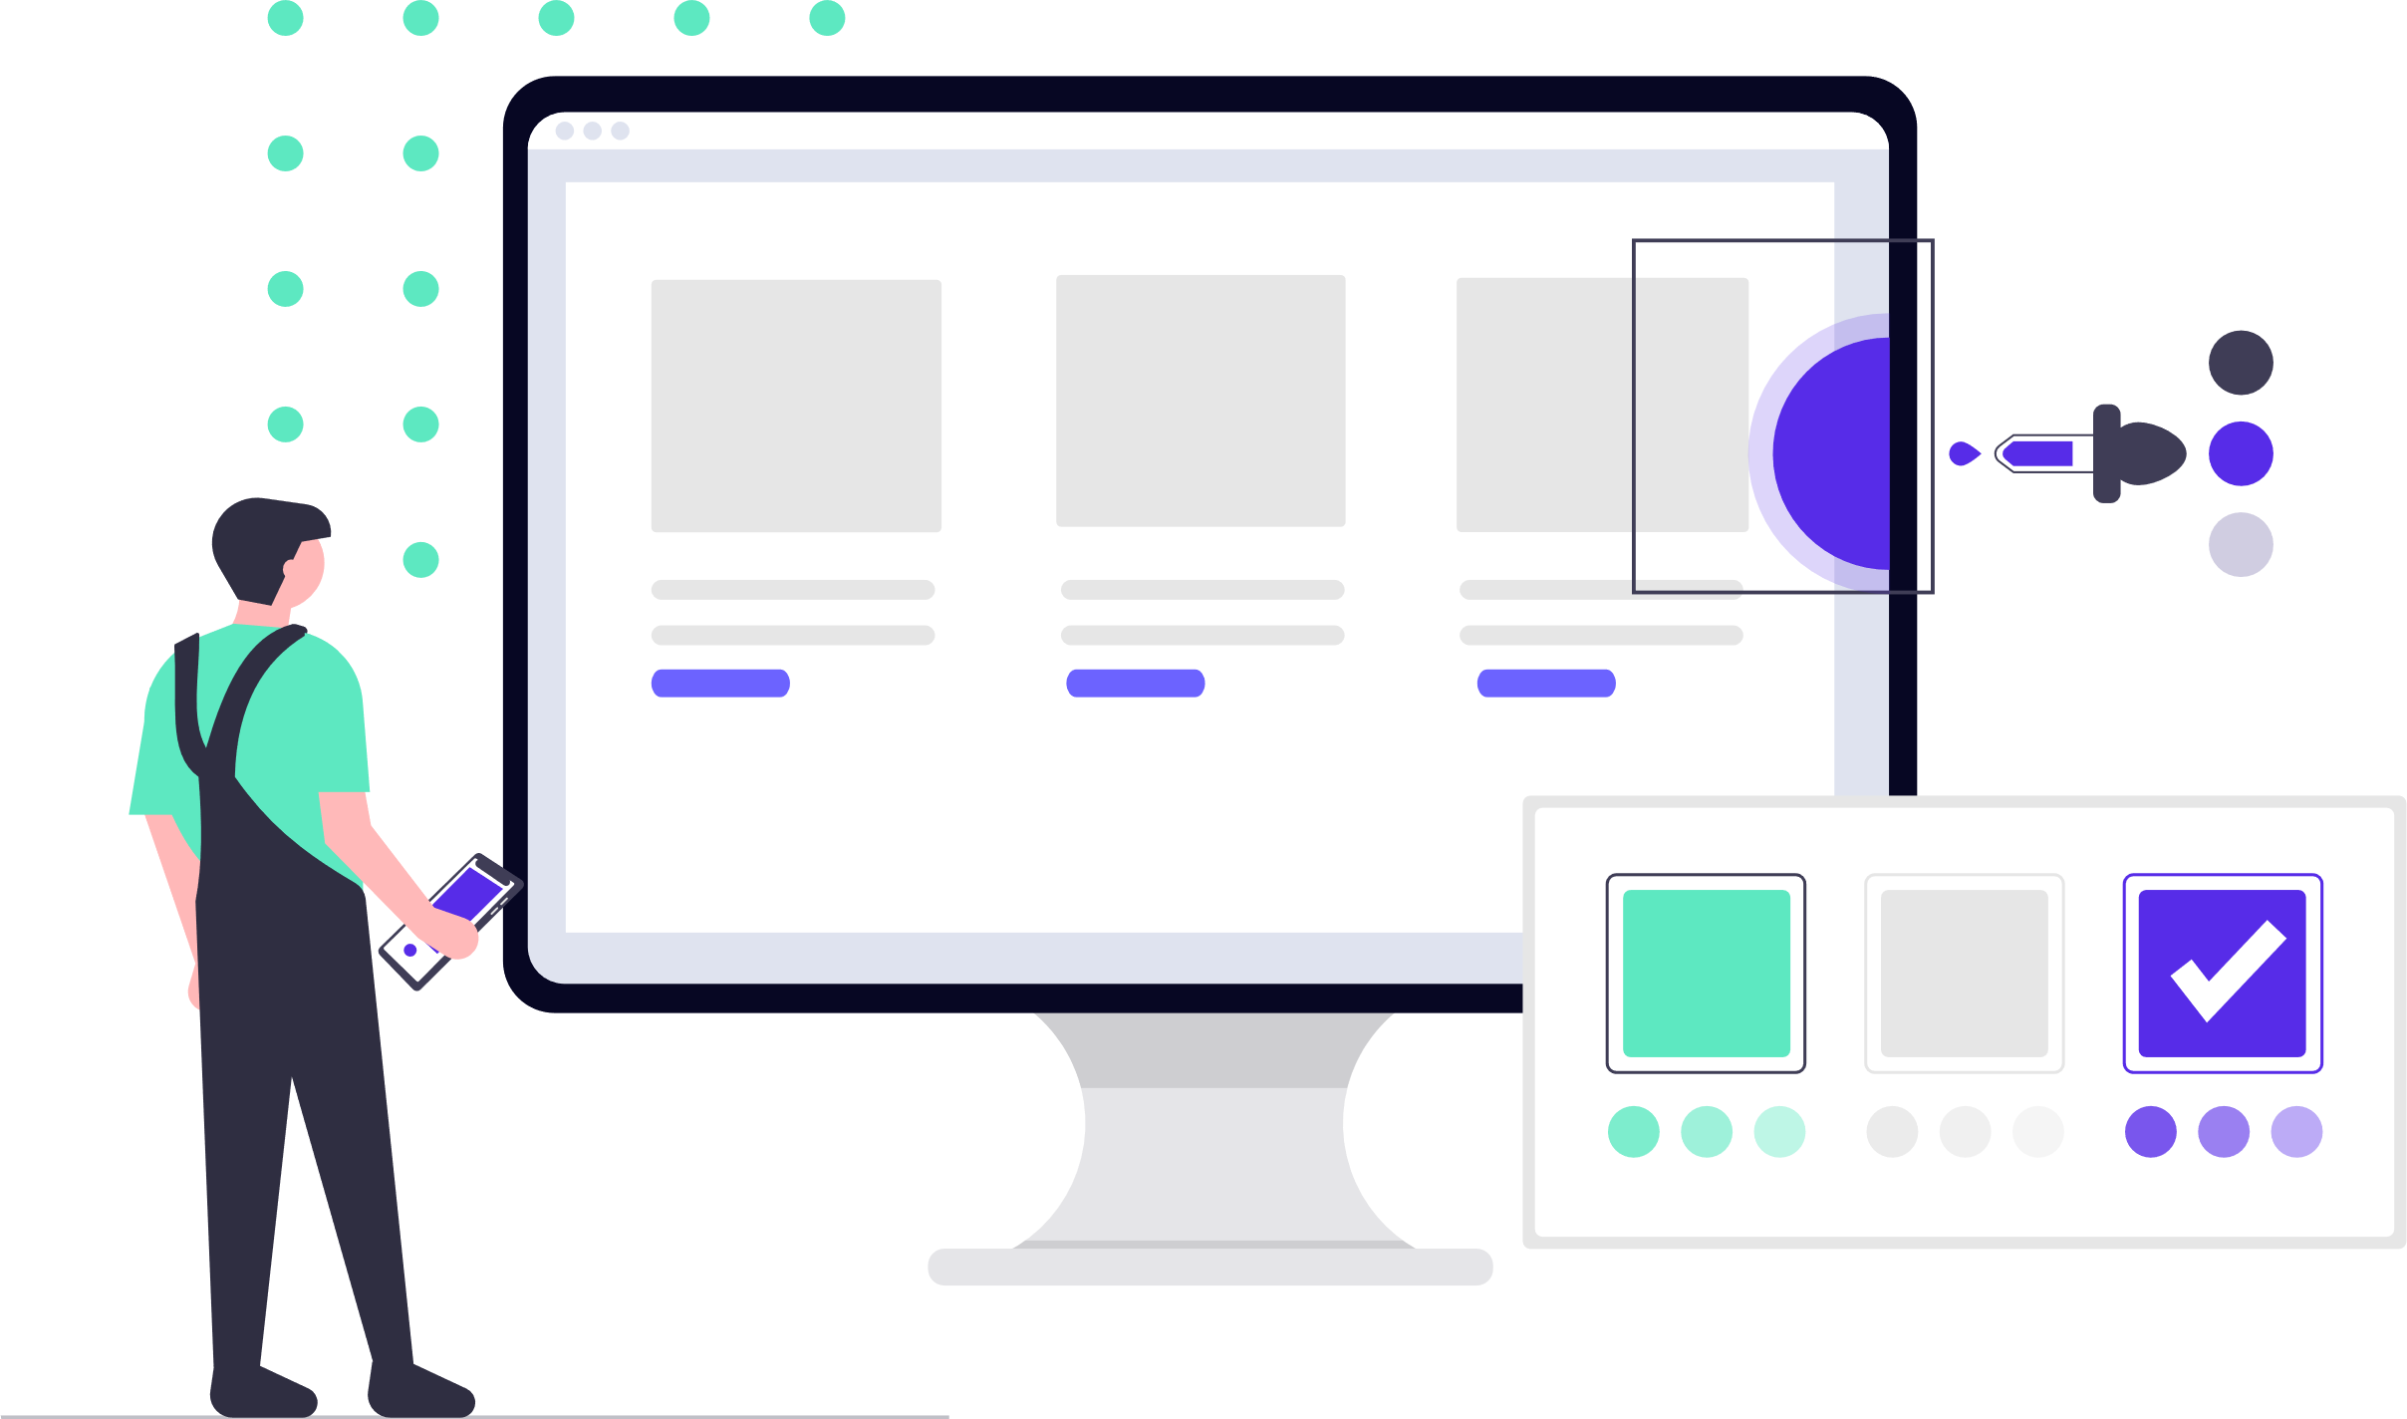
Conclusion
19/19

